Slide 1

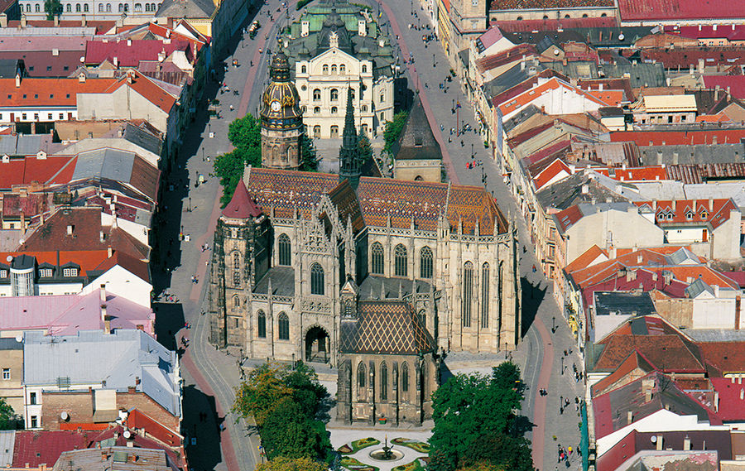

From Websites to Apps in Tourism Discourse Olga Denti, University of Cagliari, Italy
SLANG 14 29 Aug. – 2 Sept. 2014
B
A
S

Slide 2
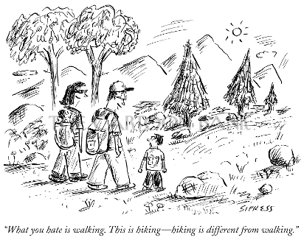
From Websites to Apps in Tourism Discourse
Literature & Methodology
Data
Institutional discourse
Apps as a genre
Conclusions

Slide 3
Literature & Methodology
DA & Genre A – Askehave, Ellerup Nielsen (2004, 2005), Bhatia (2005), Bruns (2008), Campagna, Garzone, Ilie & Rowley-Jolivet (2012), Catenaccio (2012), Garzone (2007), Garzone et al. (2007, 2010), Gotti (2005), Landow (2005), Lemke (2002 a,b, 2003, 2005, 2009), Swales (1990, 2004)
Institutional Discourse – Evangelisti Allori & Garzone (2010), Fairclough (1992, 1995 a,b), Mayr (2008), Sarangi & Roberts (1999), Van Dijk (1993 a,b, 2003); Wodak (206), Wodak et al. (1999, 2005, 2007)
Tourism & Tourism Discourse – Brown & Chalmers (2003), Bums & Novelli (2006), Dann (2004, 2012), Jansson (2002), Xiang & Gretzel (2010), McCabe (2008, forthcoming), Mahmood & Bin Abdul Salam (2013)

Slide 4
Data
Navigation/Directional Services – location-based services (e.g. Skyscanner, United Airlines, Sardegna App, iSmeralda, TripAdvisor).
Social – sharing, collaborating, communicating the tourist experience (e.g., texting, Skype, Facebook, Twitter).
Mobile Marketing – coupons, contests, etc. (e.g. Groupon).
Security/Emergency – emergency locator services, weather alerts.
Transactional – a transaction of some kind.
Entertainment – e.g., games and location-based social-networking apps (e.g., Gowalla).
Information – tourism info, travel planning and reservations, translator/money conversion apps (e.g., Babylon and XE, Booking/Airbnb; Sardinian Monuments; Sardinia Mobile Reference; Buzzd)
Notes:
Navigation/Directional Services – location-based services such as tour guiding and maps, way-finding around an area; GPS, augmented reality and transportation (e.g. Skyscanner, to scan and find the best flight for a certain destination; United Airlines, a company specific app; Sardegna App, a tour guide app or iSmeralda, a tour guide app for northern Sardinia).
Social – sharing, collaborating, communicating the tourist experience, e.g. photo, recommendations and thoughts sharing, including methods of communication such as texting and Skype.
Mobile Marketing – such as text messages for coupons, contests, etc. (e.g. Groupon).
Security/Emergency – emergency locator services, health monitoring, weather alerts.
Transactional – a transaction of some sort, money or other such as auctions, financial/banking, tickets/reservations, shopping.
Entertainment – games, movies, e-readers, music, photograph/editing, fantasy sports, and location-based social-networking apps (e.g., Gowalla).
Information – travel planning and reservations, info search relating to tourism, from general information search to guided tours without GPS, event schedule, translator/money conversion apps (e.g., Babylon and XE, assisting tourists in facilitating and increasing interaction; Booking/Airbnb – accommodation planning apps; Sardinian Monuments – attraction apps through which users can point their phone camera at a location and receive additional information; Sardinia Mobile Reference, providing information of all types).

Slide 5
Variables
The design of an app – a blend of the following variables:
Degree of engagement with technology
Features of customers/travelers
Timing
Types of info and functions
Access channels
Notes:
The most important variable which has influenced the designers of these apps are: the feature of customers to be smartphone and non-smartphone users, more in general their different degrees of engagement with technology and apps; the characteristic of customers to be frequent and non-frequent travellers, who seek different types of information – i.e. booking services versus destination information, maps and directional guides, as well as diverse types of travelers and travels that require different types of information, as well as different activities – i.e. booking, information search, what’s on, eCheck in, transport, etc. -, and different channels through which they decide to access information – i.e. tourism info centres, smartphones, a mobile computer or a computer service at a hotel or café. (to be finished)
Most of the times smartphones are exploited to serve functional, information needs, rather than to enrich the experience of travel itself. However, apps enable travelers to express their evaluations (user-generated evaluations), as we will see further on, which generates the dilemma about authoritative stance and the quality of information provided. This also leads to the coexistence of the consumer perception and communication about the destination image and the construction and communication of the institutional identity. Will they match?

Slide 6
Institutional Tourism Discourse
Institutional & professional discourse
Culture
Decontextualization & recontextualization
National and cultural identity building
Cultural representations
Brand identity & brand image
Institutional discursive genres & the discourses of marketing and promotion
Notes:
In the design of an app, the typical features of institutional discourse and the way it has changed are evident:
Institutional discourse refers to those institutional practices common among professionals and clients, exchanged between institutions, their employees and clients “characterized by rational, legitimate accounting practices which are authoritatively backed up by a set of rules and regulations governing an institution” (Sarangi, Roberts 1999: 15). Institutional communication in tourism is strongly affected by professional discourse, which entails the way professionals behave to meet their objectives (ibidem).
When investigating institutional discourse, several issues are to be addressed.
Therefore, institutional communication discourse forms an essential part of multi-layered and multi-faceted processes of identity formation, leading to a continuous negotiation and reconstruction of meaning and identity throughout the institution seen as an organization (Iedema, Rhodes, Scheeres 2005). The institution must interact with the surrounding environment in which it operates. In particular, the reference is to the tourist environment, which is a complex one, as it is characterized by very diverse contexts, settings, actors, and exceptionally dynamic and evolving scenarios.
In this environment, communication is a fundamental tool to organize and coordinate the destination management and, in particular, the communicative strategies which aim at implementing the process of image formation and identity construction, to orient the tourist perception of the destination and of its products (Evangelisti Allori, Garzone 2010).
Moreover, institutions are increasingly using discursive practices typical of the profession, of business, as if trying to persuade a customer to purchase the product. Therefore, the edges between the public and the private domains are blurring, and institutional discursive genres are strongly influenced by the discourses of marketing and promotion. The hybridization and colonization of these genres allow for less formal, cold and conservatory linguistic features, for more personal, creative and emotive messages. We witness a sort of commodification whereas “texts of the information-and-publicity or telling-and-selling sort” are frequent in institutional discourse and society, notwithstanding the lack of production for sale, distribution and consumption in a strict sense (Fairclough 1992).
Power relations become more democratic (Fairclough 1992, 1995a, 1995b; Dann 2012). The language is simplified through the use of more colloquial vocabulary, demonstratives and pronouns, the narrative present tense, fewer overt markers of power asymmetry between people of unequal institutional power (Fairclough 1992: 98) switching from information to entertainment. We assist to the conversationalization of language, to its marketization, i.e. a process influencing not only mass media but also several domains of social life to operate according to market principles.

Slide 7
Apps as a genre
The democratization of power relations
The role of customers/travelers (from Web 1.0 to Web 2.0): from feedback to new forms of interaction
Co-creation, sharing, technology & media integration, new affordances, filtering and evaluation
Hypertextuality, hypermediality & multimodality
Hypermediality: granularity, consumption modes & co-articulation
Notes:
Therefore, looking at apps as a genre, these are the characteristics that emerge:
Anyone could be involved in content creation regardless of a predetermined rigid hierarchy and better associated with the developing organizational principles of social communities. The approach to expand user-led content creation perfectly matches the rules of Web 2.0 considered as a tool to engage with other users, sharing with them data and services though an easily accessible app located between the provider and the user. The concept of produsage links different changing cultural, social, commercial, intellectual, economic and societal domains. Technology, with media integration, and new affordances, such as the lack of constraints or limitations on language, geography, background, financial status, etc., or the possibility to filter and evaluate collaborative processes and output, represent the real accomplishment. This has generated an increase in information volume and pervasiveness (Campagna, Garzone, Ilie, Rowley-Jolivet 2012) and in the development of new web genres. Sometimes, as apps may be designed in very different ways, we may think of dealing with different genres but the communicative purpose is one single one. This is a characteristic called polymorphism that apps have in common with websites (Catenaccio 2012: 33). “convergent communicative goals meant to establish and uphold interpersonal and institutional relations, enhanced inter-disciplinary and cross-cultural use of participatory affordances, multi-level strategies facilitating open access to and evaluation of information, widespread commitment to encouraging collective linguistic creativity and rhetorical emancipation” (Campagna et al. 2012: 10) not to mention hypertextuality and multimodality. In particular, hypermediality has emerged, which is “text composed in blocks of words (or images) linked electronically by paths, chains, or trails in an open-ended, perpetually unfinished textuality described by the terms link, node, network, web and path” (Landow 1992: 3). As highlighted in Campagna et al. (2012: 10), hypermediality is characterized by granularity – i.e. the text is cut in distinct units (Fig. 5, 7, 9) –, the possibility to choose among different consumption modes, i.e. linear reading and navigation, and co-articulation, i.e. the possibility for the user to opt for his/her own sequence of information access (from Fig. 2 to 10). The following slides give several examples of these characteristics according to diverse degrees.

Slide 8
 |  | Places of art and culture | Archives, Art Galleries, Collections and permanent exhibitions, Cultural centres, Deconsecrated churches, Meeting, Incentive, Congress & …, Museums, Theatres, University of Cagliari | For each: an alphabetical list of places. For each place: Picture, Info (Address, Locality, Info, Add Contact, Price, Related points of interest, Related Routes
 |  | Places of faith | Churches | For each: an alphabetical list of places
 |  |  | Convents and monasteries | For some places: Picture, Summary, Description, Info (as in the previous), Add Contact, Price, Related points of interest, Related routes
 |  |  | Crypts | For some places: Picture, Info (Address, Locality, Phone, Email, Url), Add Contact, Related points of interest
 | Visit | Places of history | Archaeological areas, Bastions, Districts, Historic palaces, Lighthouse, Monuments, Towers, Underground cavities and caves, Wells and cisterns | For each: an alphabetical list of places. For each place: Picture, Summary, Description, Info, Add Contact, Price, Related points of interest. Sometimes: Picture, Summary, Info, Add contact, Price, Related points of interest.
 |  | Places of leisure | Beaches | For each: an alphabetical list of places
 |  |  | Harbours | For each place: Picture, Summary, Info, Add Contact, Related points of interest
 |  |  | Info points
 |  |  | International Trade Fair of Sardinia
 |  |  | Panoramic views
 |  | Places of memories | Dugout | For each: an alphabetical list of places
 |  |  | Garrison defence | For each place: Picture, Summary, Info, Add Contact, Related points of interest
 |  |  | Monumental cemeteries | Sometimes a description is added
 |  |  | Pantheon
 |  | Places of nature | Green areas, Green areas parks, Hills, Naturalist areas of great interest, Wetlands and ponds | For each: an alphabetical list of places. For each place: Picture, Summary, Info, Add Contact, Price, Related photogallery, Related Routes. Sometimes: Picture, Summary, Info, Add contact, Related points of interest.
 | Enjoy | Accommodation | Bed and Breakfasts, Holiday homes, Hostels, Hotels, Residence hotel, Room rentals | For each: an alphabetical list of places. For each place: Picture, Summary, Description, Info, Add Contact, Price
Cagliari |  | Leisure | Associazione moto d'epoca, Betting agencies, Cinemas, Disco, Diving Center, Exhibition rooms, Extreme Sports, Gyms, Pedestrian areas, Pubs, Riding stables, Sport fishing, Sports facilities, Trekking, Wellness centres | For each: an alphabetical list of places. For each place: Picture, Summary, Description (sometimes), Info, Add Contact. Sometimes: only picture, Info, Related points of interest. Twice: No points of interest/No data to display
 |  | Market | Art workshops, Bookshops, Enogastronomia tradizionale, Handicraft and souvenirs shops, Markets, Open-air markets, Wine shop | For each: an alphabetical list of places. For each place: Picture, Summary, Description (sometimes), Info, Add Contact, Related points of interest (sometimes)
 |  | Public services | Awereness Campaign, Bathing Establishments, Beaches Services, Bike rental, Chemists, Consulates, Hospitals, Infopoint, Internet points, Libraries, Lifts (Elevators), Multimedia Libraries, Newspaper reading rooms, Payphones, Photobooths, Post boxes (Mailboxes), Post offices, Public toilets, WIFI zones | For each: an alphabetical list of places. For each place: Picture, Summary, Description (sometimes), Info, Add Contact, Related points of interest (sometimes)
 |  | Tourism | Affitto case vacanze, Boat escursions, Fish tourism, left-luggage, Marinas, Open-top bus tour, torusit guides associations, Tours, Travel agencies | For each place: Picture, Summary, Description (sometimes), Info, Add Contact, Related points of interest (sometimes)
 |  | Transports | ARST, Airport, Airport shuttle buses, Bus station, Buses for disabled people, Cagliari International Container …, Car parking lots, Car rental and hack services, Ctm, Delibery Service, Free Parking areas, MetroCagliari, Motorcycle parkings, No traffic areas, Port, Public transports, Railway station, Taxi and Taxi ranks | For each: an alphabetical list of places. For each place: Picture, Info, Add Contact, Related points of interest (sometimes)
 |  | Where to eat | Bars, Coeliacs restaurants, Ethnic restaurants, Fast foods, Ice-cream parlour, Pizzerias, Restaurants, Slow foods, Vegetarian and Vegan restaurants | For each: an alphabetical list of places. For each place: Picture, Summary, Description, Info, Add Contact, Price
 | Events | Calendar
 |  | Description of a special exhibition Mar 14 - Dec 30
 | Routes Itineraries | A trip around museums, Bonaria Tour, Cagliari Archeologica, Poetto beach Tour, Sunday Morning Markets, The Old Way of teh Cross, The shopping Streets, Villanova district, Visit to Castello district, Visit to Marina district, Visit to Stampace district | For each one: Identification on the map. Summary, Description, Related points of interest
 | Gallery | Beaches, Bonaria, Botanic Gardens, Castello - Historic District, Cagliari Tour, Galleria dello Sperone, Historic and Cultural Places, Historic Districts, Holy Week 2011, Is Misterius 2011, Marina - Historic District, MEM - Mediateca Emeroteca del Mediterraneo, Municipal Art Gallery, Parchi, Port of Cagliari, Stampace - Historic District, Sant'Efisio, Sea and Sports, Teatro Lirico (Opera House), Villanova - Historic District, Views. | Pictures only, with no text
Notes:
First of all, the presence of different paths the user can choose are evident from the map of the app textual organization

Slide 9
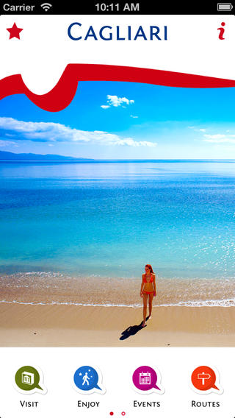
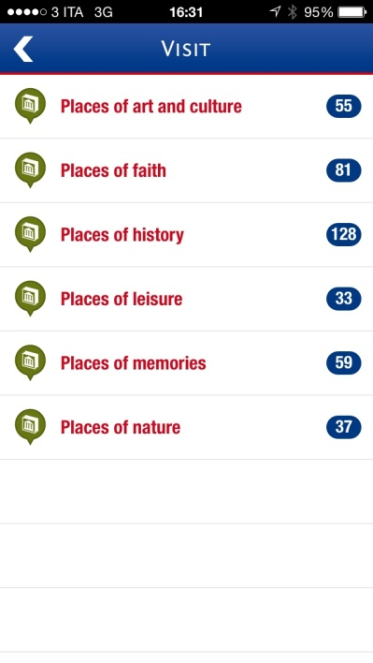
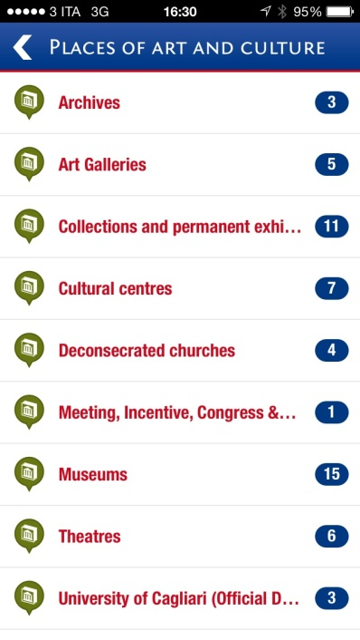
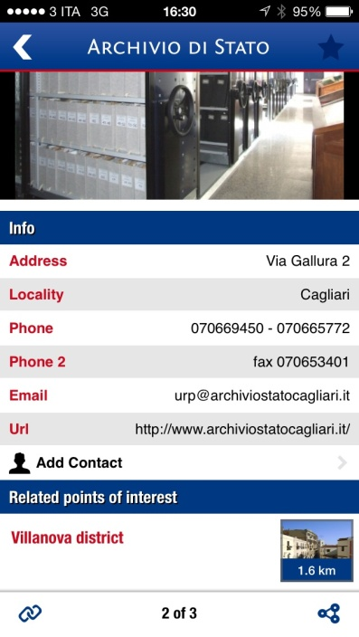
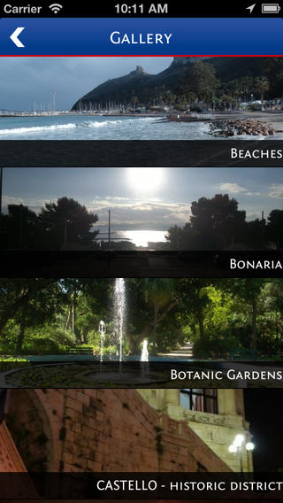
Cagliari
Notes:
This is another way to look at it.
If we consider the app for the city of Cagliari as an example (Fig. 1), once the app has been accessed, the user may choose which topic to click (Visit, Enjoy, Events, Routes, Gallery), which type of information (Places of art and culture, of faith, of history, of leisure, of memories, of nature), which additional details to look at either located on a map or textually described and linearly readable. Related points of interest are also clickable to further broaden the research. Sometimes the same information is accessible from different paths, for example, if the user chooses an itinerary (Routes) reaching at the end the same descriptions, differently gathered, he/she would reach from Visit. Users can choose where to go, how to put together sequences of information from a logic, temporal, experiential point of view, and what meaning to make on their own (Lemke 2002 b: 52).
The other feature, once again exceptionally enhanced by app technology, is multimodality, the use of several diverse modes in the design and construction of the app itself, which enables the user to easily and simultaneously access the media and links, providing “the opportunity to combine different semiotic resources into a single communicative act” (Campagna et al. 2012: 11). If we consider Cagliari app again, the first page basically shows the picture of Cagliari’s Poetto beach and of a woman, who both represents the destination and the tourist, inviting the user to come and experience, framed by several icons that render the page layout clean, easy to read and effective. The first icon following the Western sequence, top left corner is the star, which throughout the web represents Favorites (preferred sites/topics). Then, it is followed by the i sign (information), which is a little misleading, as it refers to the Credits. However, it is an important section as it directly encourages people to give a feedback by rating the app (Rate on AppStore) and to signal errors (Found and error?), in a colloquial way, employing an exhortative/conative imperative in the first case, and an elliptical question form in the second one. On the bottom of the screen, we see the main topics, highlighted in the different colors and icons: the symbol of archaeology for Visit, a walking person for Enjoy (pragmatic information on accommodation, eating and tourism services available in the area), a calendar to symbolize Events, a road sign for Routes and the typical symbol of landscape picture present on cameras to indicate the access to the Gallery.

Slide 10
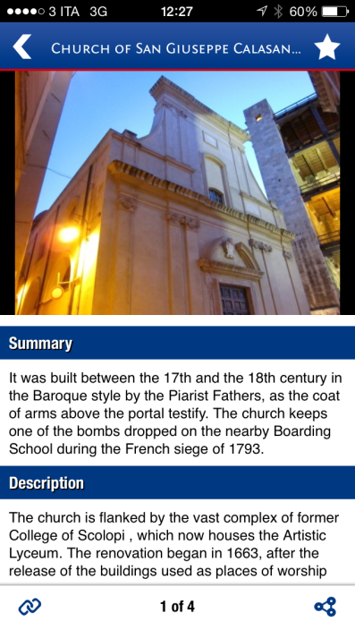
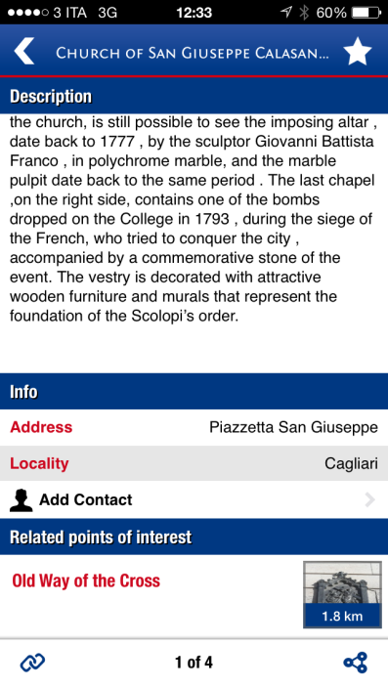
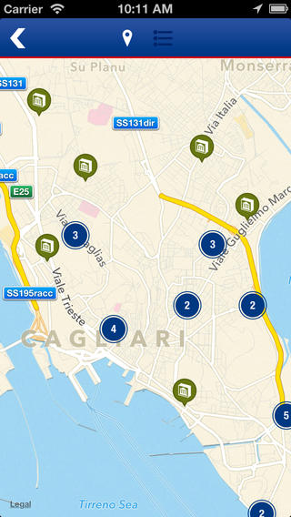
Cagliari 2
Notes:
Given these characteristics and the unlimited extension of the Internet participation framework, the definition of textual moves has become difficult and unstable (Campagna et al. 2012:11), especially if we consider the possibility for the users not only to download information but also to upload text and images, contributing to build the app and personalize it, to interact with the app, share on social networks, and look at information through a path which may change each time.
Co-construction and multiple authoring affect the function of media, the text, due to the different role of the user/author, their stance, background and expertise (are we all experts?), textual coherence, and, in the end, textual genres which are increasingly becoming hybrid (Campagna et al. 2012: 13).
This has led to consider the influence of computer systems and computer-mediated communication practices on genre theory and viceversa, as they are increasingly bound together (Yates, Orlikowski, Renneker 1997, Catenaccio 2012, Garzone 2007).
First of all, a sort of migration has originated in moving texts from traditional media to the hypertextual and multimodal environment (Catenaccio 2012: 30). The combination of hypertextuality and multimodality gives origin to hypermodality where all semiotic objects are to be considered in their interaction (Lemke 2002 a: 301). The resulting connections, which link both diverse communicative modes (text, music, images) and genres (reports, instructions, calendars, biographies) are called traversals: “virtual genres which transcend the traditional norms of time and space in specific, fragmented ways, constructing hybrid patterns of coherence” (Wodak 2006: 3 and Lemke 2003, 2009, in Catenaccio 2012: 30). As an example, Fig. 7, which is very simple in its design and content, summarizes this concept. First of all, it needs to be considered dynamically and not statically, because the links are there to complete the page meaning. Apart from very short descriptive, narrative, expositive, instructive and hardly ever argumentative texts, throughout the app written content is often substituted by a map location or a link to another page (Fig. 9-10). For example, sometimes the address is defined by words and written details (Fig. 5), sometimes only the name of the street or square is written down and clickable to be visualized on a meticulous map (Fig. 10).

Slide 11
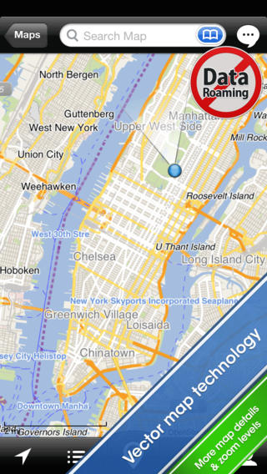
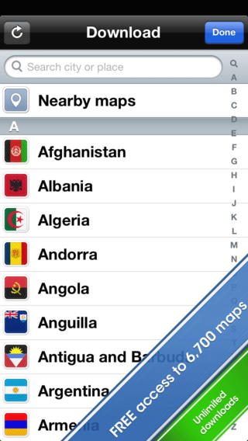
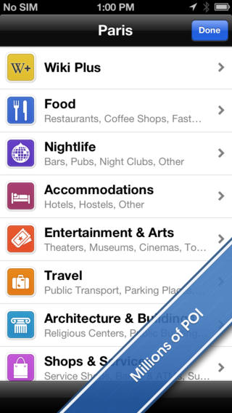
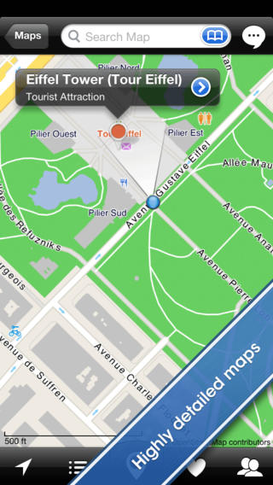
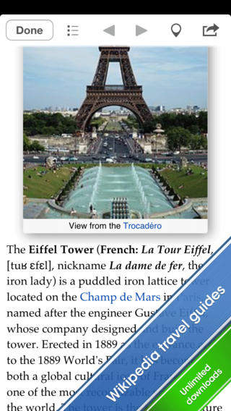
City maps 2go
Notes:
More examples

Slide 12
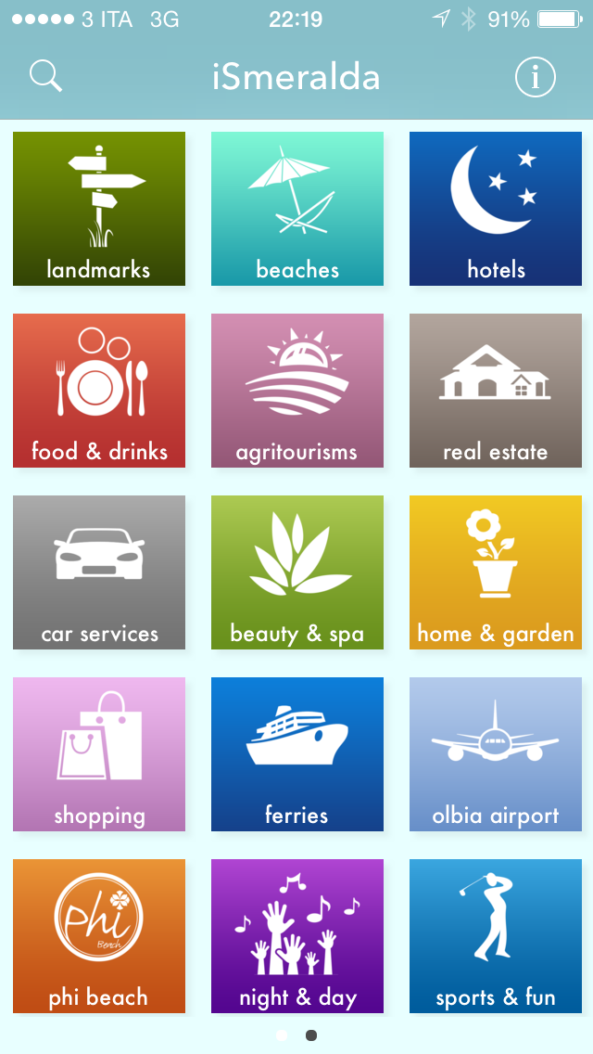
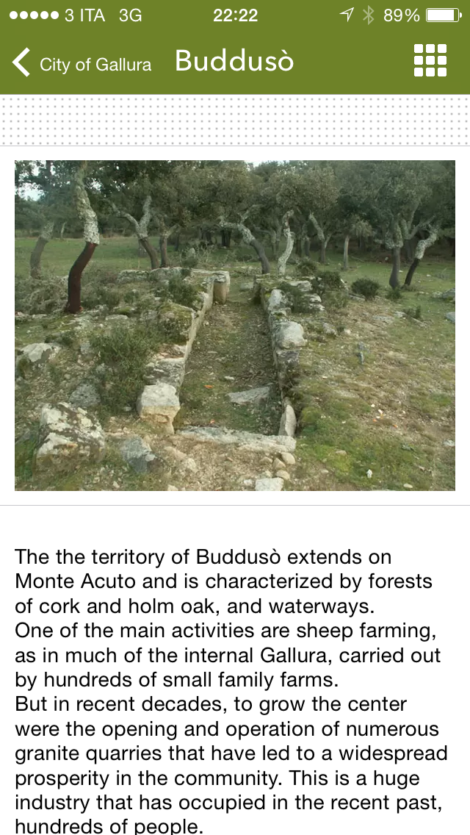
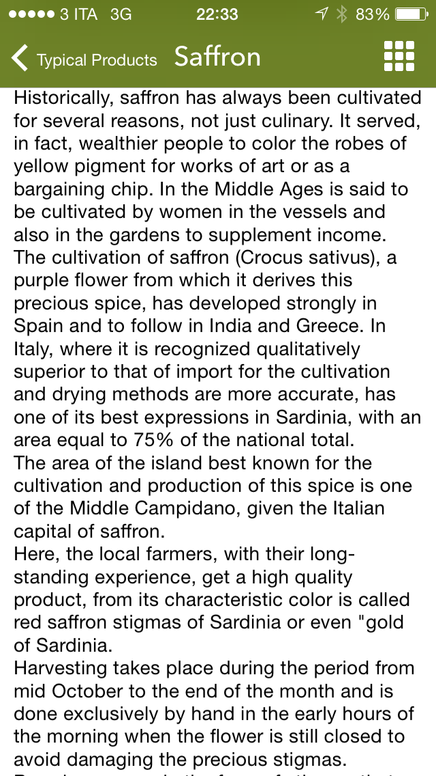
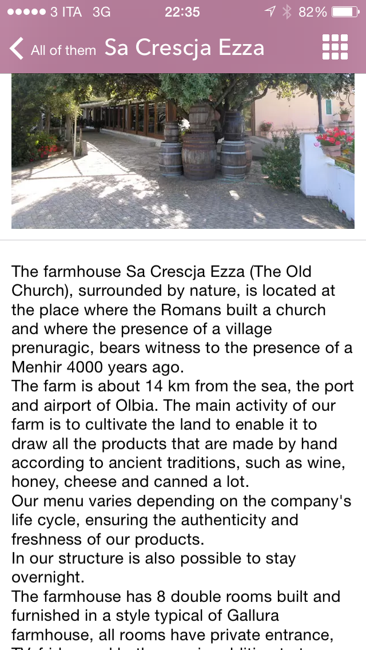
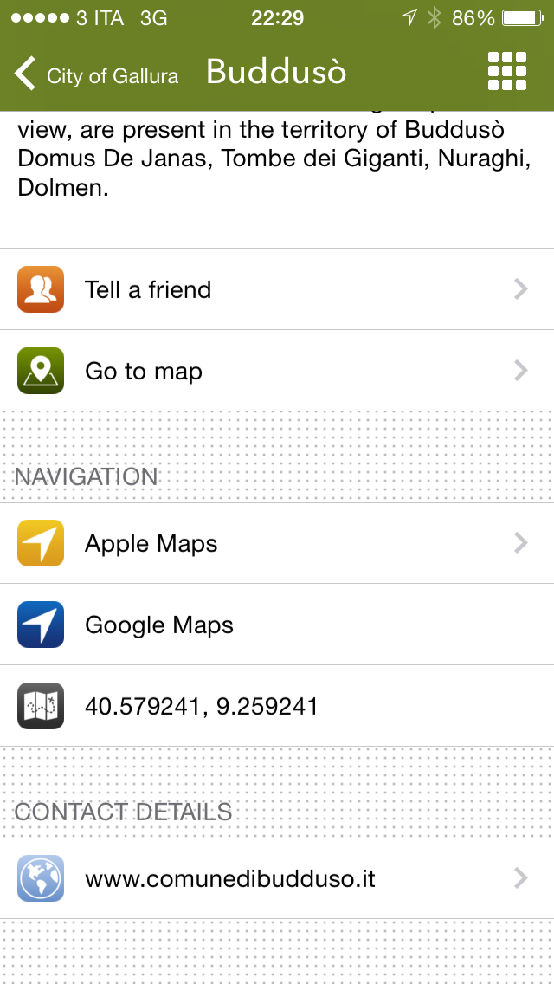
iSmeralda
Notes:
A comparison between Cagliari, City maps2go, iSmeralda, Visit Sulcis. Different degrees of technology, information details, hypertextuality, text types
Predominance of certain text types
The instructive basically replaced by interactive sequences
However, as often text types identify diverse genres, and the difference between items is not only semiotic, we can often recognize individual and definite genres which “come to play and interact in the broader semiotic space inhabited by the communicative event as a whole” (Catenaccio 2012: 31). This is why in hypermodality we need to focus more on the relationship among the genres identified than to analyze the genres individually recognized (Swales 2004).

Slide 13
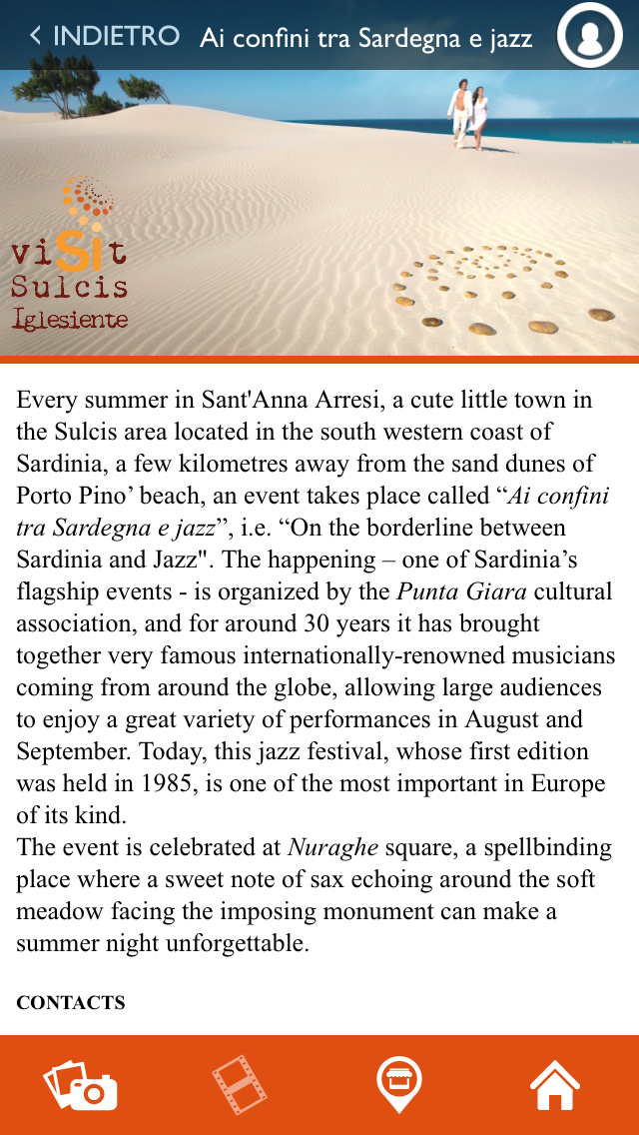
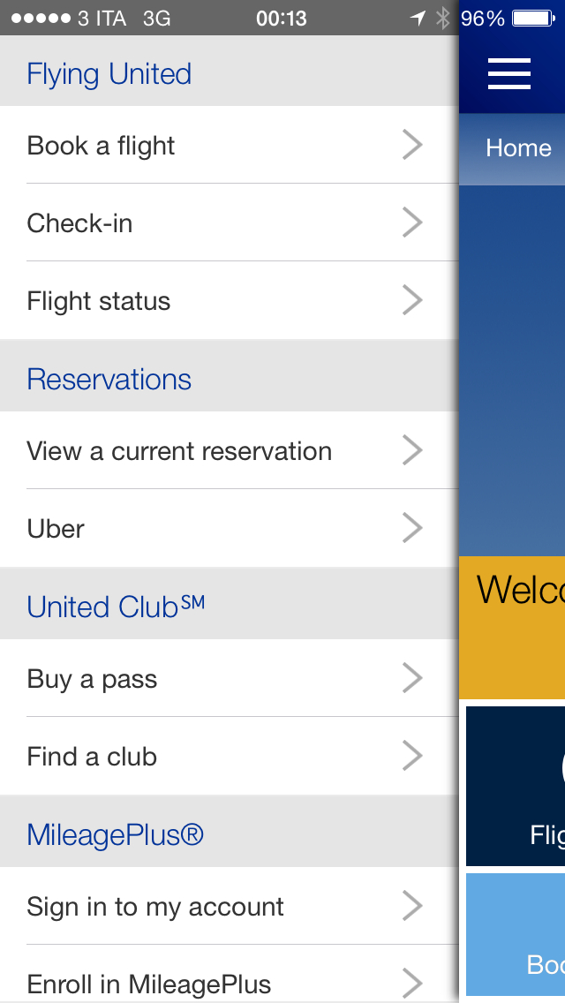
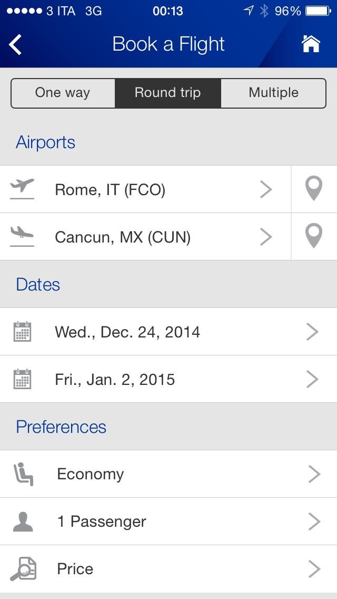
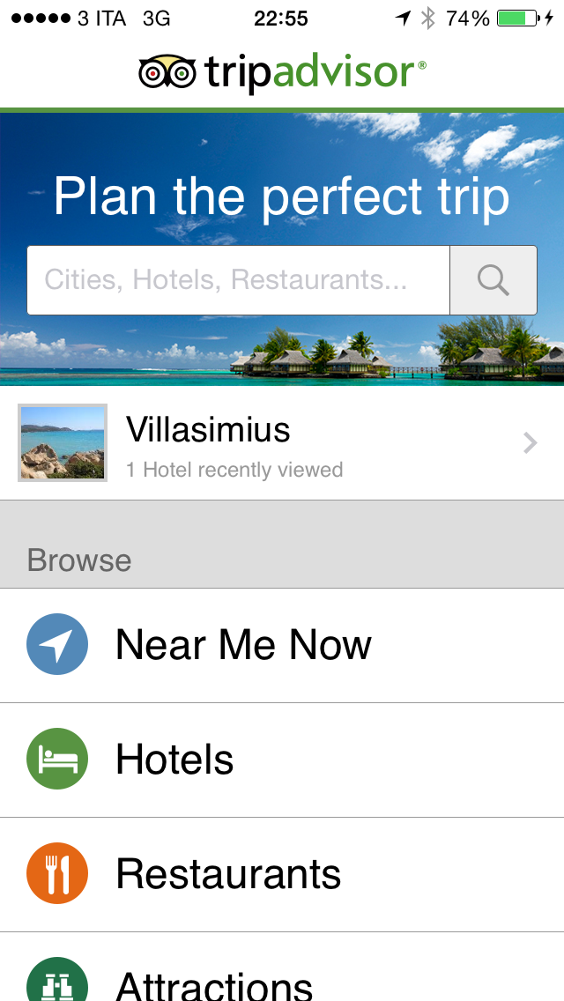
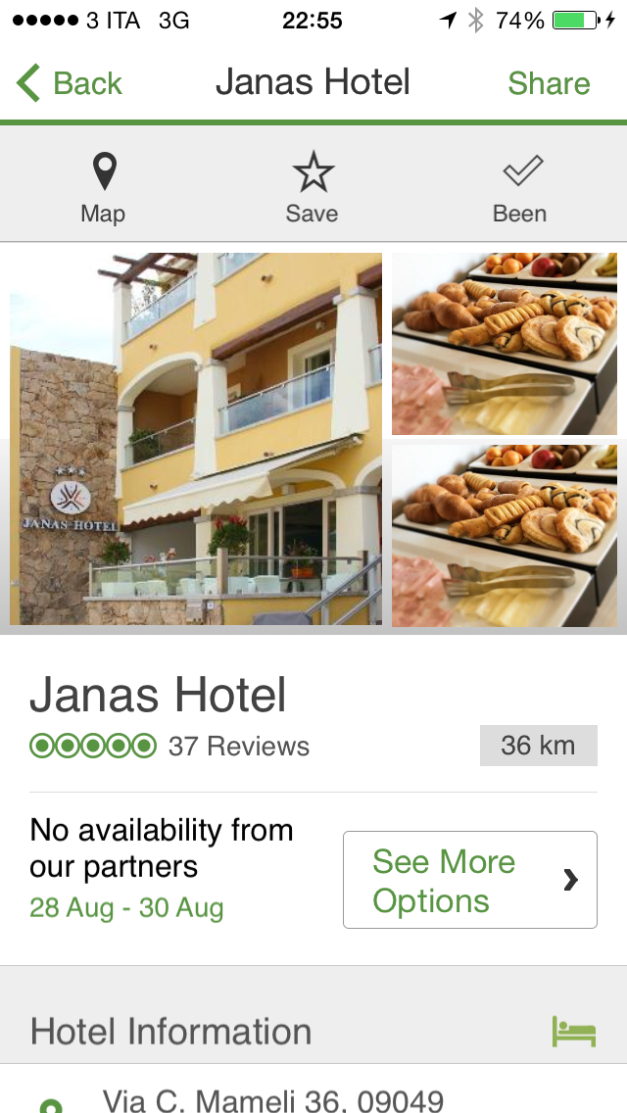
Different degrees…
Notes:
From basically textual apps with little interaction and co-creation, to performative apps almost lacking texts.
It does resemble a book index but, unlike it, it is dynamic as it gives access to several topics, suggesting diverse paths and producing traversals across documents identifying specific genres (Catenaccio 2012: 34, Lemke 2005). Hypertext functions as the medium through which the app, as a genre, develops. Unlike websites, most apps have definite boundaries within which the user can move, though sometimes the link goes to an outside site. An app functions as a rhetorical interface, i.e. an intermediary “between the affordances of the medium and the rhetorical function(s) of genres” (Catenaccio 2012: 35).
Therefore, the key idea is that, on the one hand, the app is a genre with specific features, and, on the other, it is made up of different genres, according to its particular communicative purpose

Slide 14
Conclusions
Genre system
Types & purpose
Audience
Network of genres
Notes:
As already mentioned, there are different types of apps (Navigation/Directional Services, Social, Mobile Marketing, Security/Emergency, Transactional, Entertainment, Information; cfr. Denti forthcoming) and they would identify different types of genres. However, they also share a general communicative purpose and rhetorical expectations. Moreover, they share some general characteristics, as above mentioned.
Yates, Orlikowski and Rennecker define it as genre system, which is “an interrelated sequence of genres enacted by members of a particular community. (…) Such systems are composed of a well-coordinated set of communicative moves that together accomplish an interaction (…) (T)he system as a whole, as well as the individual genres constituting the system, can be said to have a socially recognized purpose and common characteristics of form” (1997).
They also highlight that this is especially applicable in the presence of digital media, of “collaborative communicative activities in electronic media, because a genre system is an interlocking and interdependent set of genres that, by definition, requires collaboration” (ibidem).
Another element that needs to be taken into account is the definition of the audience. The writer and the designer of an app must have in mind a particular addressee they want to reach. Tourism communication is dialogical. This is of course determined in relation to the information provided. However, when dealing with the Internet, we can’t really constrain the audience who will access the app. In addition, the multiple navigation paths that are offered may lead different users to diverse results. This aspect is better dealt with in Swales’ concept of genre network, as “networks operate at an intermediate level between the structural properties of institutions (…) and the communicative activities of single individuals. Having a network frame allow us, by tracing intertextual links and other kinds of recontextualization, to place individual genres within a heuristically valuable wider concept” (Swales 2004: 23).
Apps as a network of genres:
less rich than websites due to the conciseness of their texts
accessed through variable and unpredictable sequences and recontextualization processes
The result is in the construction of user-generated traversals within an institutional framework

Slide 15
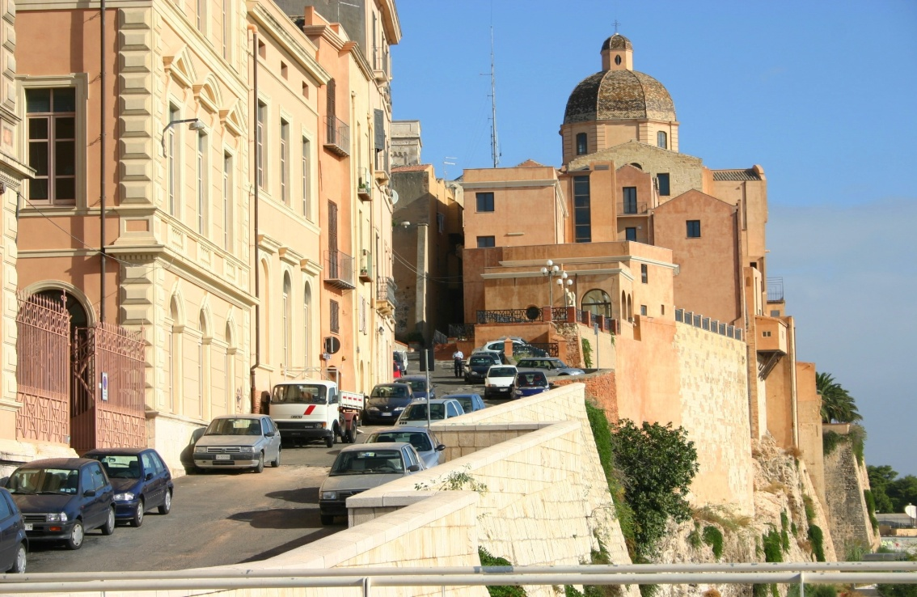
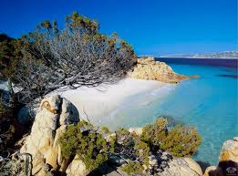
From Websites to Apps in Tourism Discourse
THANK YOU VERY MUCH!!!
Olga Denti
University of Cagliari
odenti@unica.it

