Slide 1
The Banking Union
Foundations and pillars of the European response to the financial crisis
Giuseppina Cannas European Commission – DG COMP
A3 – State aid strategy

Slide 2
Outline
The financial and economic crisis
Financial crisis and bank bail-outs
The sovereign-bank doom loop
The European response to the crisis
The Banking Union
The Single Rulebook
The Single Supervisory Mechanism (SSM) – the first pillar
The Single Resolution Mechanism (SRM) – the second pillar
The European Deposit Insurance Scheme (EDIS) – the third (missing) pillar

Slide 3
The financial and economic crisis

Slide 4

The 2008 financial crisis and bank bail-outs
In 2008, the financial crisis emerges in the EU.
The financial crisis was very severe - 400 cases of State aid to the financial sector (2008-2012), the European Commission authorized total aid corresponding to around 30% of EU GDP in 2013 for guarantees on liabilities + an additional amount spent on the public recapitalization of banks corresponding to 3.4 % of EU 2013 GDP.
Why? When enterprises go burst, they are normally put into insolvency and they exit the market.
Banks are special enterprises whose collapse may have systemic implications. This is why public money has been used to ‘rescue’ banks.
Too big to fail
The financial crisis revealed a lack of clarity about how to react to a distressed banking sector.
Crisis management/resolution tools were, if existent, national
Lack of cross-border cooperation in the way that would be ideal and also in terms of the tools available to the competent authorities to deal with the failure of large financial institutions.

Slide 5

The Euro Area Debt Crisis - The sovereign-bank doom loop
As the crisis advanced, its effects spilled over from banks to the real economy.
The sovereign-bank nexus: Euro area sovereign bonds in total bank assets.
Several euro area Member States were unable to repay or refinance their government debt and/or to bail out their “national” banks without assistance from the European Central Bank (ECB), or the International Monetary Fund (IMF).
Whatever it takes (2012)
European Stability Mechanism (ESM) was created in 2012 to provide direct financial assistance to euro area Member States experiencing financing difficulties
ESM issues debt instruments in order to finance loans and other forms of financial assistance.
Crisis deepens
Banks need support
by national government
Weaker bank
Balance sheet
Fiscal position of
Government weakened
Refinancing costs rise:
Higher debt yields

Slide 6



The financial and economic crisis
Bank capital and liquidity
Many banks were vulnerable because:
the quality and quantity of their capital reserves was insufficient
they had insufficient short- and long-term liquidity
Public Finances and bank bail-outs
National governments had to give unprecedented financial support to the banking sector, compromising financial stability.
Depositor Protection
Minimum level of harmonization between domestic deposit guarantee schemes in the EU.
During the financial crisis, it proved disruptive for financial stability and the internal market.

Slide 7
The European response to the crisis

Slide 8

The EU response: the Banking Union
Pillar 1
2013
Single Supervisory Mechanism
(SSM)
ECB + NCAs
Pillar 2
2014
Single Resolution Mechanism
(SRM)
SRB + NRAs
Pillar 3
European Deposit Insurance
Scheme
(EDIS)
Banking Union
EU 19
Single Rulebook
EU 28
CRD/CRR
BRRD
DGSD

Slide 9
The Single Rulebook
This single rulebook is the foundation for the banking union.
It forms the harmonized prudential rules that all financial institutions in the EU must comply with and on which Banking Union depends. It includes:
CRD IV / CRR
Requires banks to keep sufficient liquidity and capital reserves. The goal of these rules is to strengthen the resilience of the EU banking sector so that it can better absorb economic shocks, while ensuring that banks continue to finance economic activity and growth.
BRRD
Sets the rules for managing failing banks.
Addresses the “too big to fail”.
Resolution framework to avoid that taxpayers are liable to bail out troubled institutions.
DGSD
Protects depositors in a harmonized way. Deposits below EUR 100.000 are guaranteed by a mandatory insurance scheme founded by private money from the banking sector.
Notes:
The Single Rulebook consists of a series of level 1 legislation adopted by the EU Parliament and the Council of the European Union (the Council), complemented by level 2 delegated legislation and implementing acts prepared and drafted by the European Banking Authority (EBA) and adopted by the European Commission in cooperation with Member States Committees. These Regulations are directly applicable and do not need to be transposed in national law. These legislative measures are further complemented by EBA “soft law” guidance.

Slide 10
First Pillar
The Single Supervisory Mechanism (SSM)

Slide 11

The Single Supervisory Mechanism (SSM)
The European Central Bank (ECB) is the supervisor of financial institutions in the euro area, together with the national supervisory authorities
Significant Institutions (SI) are under the ECB’s direct supervision. Around 120 banks (list). The list of SI is updated by the ECB in the first week of every month.
National Competent Authorities (NCAs/supervisory authorities) remain primarily responsible for the supervision of less significant institutions (LSI) in close cooperation with the ECB (indirect supervision).
The ECB operates via Joint Supervisory Teams (JSTs) comprising ECB staff and relevant national supervisors.
They carry out ongoing supervision of significant banks, in particular the Supervisory Review and Evaluation Process (SREPs) supervisory examination programs, and they are responsible for coordination with on-site inspection teams.
The ECB carries out financial health checks of the banks it supervises directly (comprehensive assessment). The assessment usually comprises two main pillars:
An Asset Quality Review (AQR) – to enhance transparency regarding banks’ exposures, including as regards the adequacy of asset and collateral valuations and related provisions
A Stress Test, performed in close cooperation with the European Banking Authority (EBA) – to test the resilience of banks’ balance sheets
Notes:
The SSM delivers prudential supervision led by the European Central Bank (ECB) as the supervisor of financial institutions in the euro area, together with the national supervisory authorities of the participating member states (i.e. all euro area member states and those who choose to participate by “opting-in”). Around 129 “significant” banks are under the ECB’s direct supervision, representing approximately 82 % of euro area bank assets.
National Competent Authorities (NCAs/supervisory authorities) remain primarily responsible for the supervision of “less significant”, i.e. smaller, banks in close cooperation with the ECB (indirect supervision). In practical terms the ECB has to apply divergent national laws implementing CRD IV. It operates via Joint Supervisory Teams (JSTs) comprising ECB staff and relevant national supervisors. The JSTs foster a common supervisory culture and promote consistent supervisory practices and approaches.
They carry out ongoing supervision of significant banks, in particular the Supervisory Review and Evaluation Process (SREPs) supervisory examination programs, and they are responsible for coordination with on-site inspection teams.
Before formally taking on its responsibilities in November 2014, the ECB conducted a “comprehensive assessment”, including an Asset Quality Review (AQR) and stress tests, of banks that would fall under its remit. Of the 130 banks assessed, 25 banks were found to have a capital shortfall.

Slide 12
Second Pillar
The Single Supervisory Mechanism (SSM)

Slide 13



Why bank resolution? - General principles
Ensure the continuity of critical functions
Protect financial stability, in particular by preventing contagion
Protect public funds
Protect depositors covered by the Deposit Guarantee Scheme Directive (DGSD)
Protect client funds and client assets
Notes:
As a consequence, the European legislator established a toolkit that allows the orderly resolution of banks without compromising financial stability and without resorting to public funds.

Slide 14

The Single Resolution Board (SRB)
Established by the SRMR, the Single Resolution Board (SRB) is the central resolution authority within the Banking Union. It has been operational as an independent European Union Agency since January 2015.
It forms the SRM, together with the National Resolution Authorities (NRAs) of participating Member States (MS).
SRB’s remit
The SRB has competence over the Significant Institutions (SI) + cross border banking groups.
NRAs have competence over the Less Significant Institutions (LSI)
Activities
In normal times, resolution planning is the main activity of the SRB and of any RA, in order to be well prepared in case a concrete banking failure has to be handled (proactive role).
In crisis case, the SRB decides if resolution will be applied and in case enacts the resolution scheme (based on resolution plan + market conditions).
The SRB also manages the Single Resolution Fund (SRF), to provide financial support in exceptional circumstances.

Slide 15


What happens to an ailing bank? The first signs: Early Intervention Measures
(Art. 27-30 BRRD)
Early intervention measures empower supervisors – not the resolution authority – to react to an escalation of financial problems at an early stage, well before an institution fails
Trigger: “rapidly deteriorating financial condition”, including a deteriorating liquidity situation, an increasing level of leverage, an increase of NPL portfolios, a concentration of exposures, and in relation to own funds, 1.5 pp above the level of an institution’s own funds requirement.
If early intervention has been triggered, a variety of measures are available to supervisors:
Implement measures set out in the recovery plan
Changes to the institution’s business strategy, its legal or operational structures, or the negotiation of debt restructuring
Temporary administration replacing senior management and control bodies
Notes:
First signs of financial difficulties within a bank.
About Carige: The decision to impose temporary administration is an early intervention measure aimed at ensuring continuity and pursuing the objectives of a strategic plan.
The appointment of the temporary administration results in the removal of Banca Carige’s management and control bodies.

Slide 16
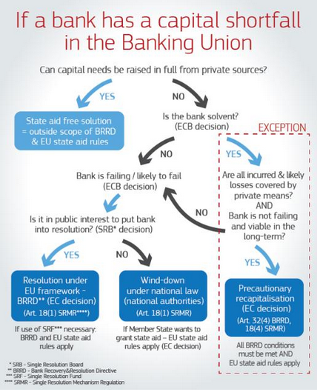
What happens to a bank with a capital shortfall?

Slide 17
Resolution trigger
Triggers for resolution:
The ECB (and/or the SRB) determine that the entity is FOLTF;
Private sector measures or further supervisory actions must be explored;
Resolution must be in the public interest (SRB performs the Public Interest Assessment - PIA). Resolution action has to be taken if the resolution objectives (Art. 31 BRRD) would not be met to the same extent if the bank were wound up under normal insolvency proceedings.
If all the conditions for resolution have been met, it is for the resolution authority to take a decision about the best resolution approach (which resolution strategy?, which resolution tool?), based on the resolution plan, which has been prepared ex-ante, and on the current market conditions.
National insolvency proceedings (NIP)
If the resolution authority considers that resolution action is not warranted in the public interest, EU law stipulates that the bank is wound down in line with national insolvency law.
It is the responsibility of the national authorities to apply national insolvency law.
Notes:
Pre-conditions for resolution:
1) FOLTF is primarily a responsibility of the Supervisor, but also the resolution authority can have a role
2) Determination whether there is any residual action of supervisory or private nature which may still avoid resolution
3) Determination whether the resolution action is in the public interest.

Slide 18
The resolution tools
If a bank meets all the 3 relevant conditions, the SRB places the bank under resolution.
The SRB enacts a resolution scheme, which determines what resolution tools are to be applied to the bank and, if necessary, whether the SRF is to be used to support the resolution action.
PRECONDITION: Before any resolution action is taken, the capital instruments of the bank must be written down or converted into capital.
The resolution tools are:
The Sale of business
The Bridge Bank TRANSFER TOOLS
The Asset Management Vehicle
Bail-in tool
Decision as to which resolution tool(s) would be applied to best achieve the resolution objectives.
More than one resolution tool can be applied.
Notes:
Pre-conditions for resolution:
1) FOLTF is primarily a responsibility of the Supervisor, but also the resolution authority can have a role
2) Determination whether there is any residual action of supervisory or private nature which may still avoid resolution
3) Determination whether the resolution action is in the public interest.

Slide 19
The transfer tools
The Sale of business
(partial) transfer to a private purchaser on commercial terms
The Bridge Bank
Package of assets, rights and liabilities transferred to public bridge bank controlled by the RA → the BB helps ‘clean’ the bank and make the bank appealing for the market.
Balance Sheet of the bridge bank must be balanced! (TA >= TL)
The legacy bank exits the market.
Temporary measure → An exit strategy must be considered since the set-up.
The Asset Management Vehicle
Only in conjunction with another tool!
Transfer of bad assets to an asset management vehicle
Notes:
Pre-conditions for resolution:
1) FOLTF is primarily a responsibility of the Supervisor, but also the resolution authority can have a role
2) Determination whether there is any residual action of supervisory or private nature which may still avoid resolution
3) Determination whether the resolution action is in the public interest.

Slide 20
The Bail-in tool
Bail-in allows to write-down shareholders’ and creditors’ claims and to convert creditors’ claims into equity.
Loss absorption through write-down and/or conversion of eligible liabilities. Recapitalisation to the extent necessary to restore its ability to comply with the conditions for its authorization.
Principles on loss allocation
Shareholders bear losses first
Creditors bear losses:
in accordance with the order of priority of their claims in insolvency
Creditors of the same class are treated in an equitable manner
No creditor shall incur greater losses in resolution than in normal insolvency (No Creditor Worse Off principle)
Exclusions in line with the resolution principles: e.g. covered deposits, secured liabilities, very short term maturities, etc.
MREL
The minimum requirement for own funds and eligible liabilities (MREL) ensures there are always some liabilities to be bailed-in. MREL is a subset of the eligible liabilities. MREL does not limit the application of bail-in
Notes:
Pre-conditions for resolution:
1) FOLTF is primarily a responsibility of the Supervisor, but also the resolution authority can have a role
2) Determination whether there is any residual action of supervisory or private nature which may still avoid resolution
3) Determination whether the resolution action is in the public interest.

Slide 21
Third Pillar
European Deposit Insurance Scheme (EDIS)

Slide 22
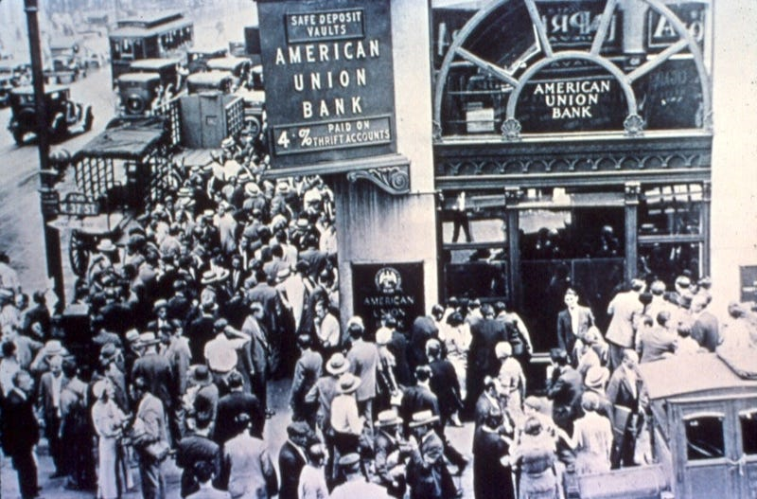

Depositor Protection – the current framework
Depositor protection: Under EU rules, in the case of bank failure Deposit Guarantee Schemes (DGS) protect depositors' savings by guaranteeing deposits of up to €100,000 per depositor.
Depositors protection prevents bank runs, which can create financial instability
DGS are funded entirely by banks! No taxpayer money is used.
1994
Original DGSD - Minimim harmonization
2009
Ameding Directive – increse level of protection to EUR 100,000 by 2010
2014
Directive 2014/49/EU

Slide 23
Depositor Protection – Directive 2014/49/EU (DGSD 2014)
Key elements
Legislation: Deposit Guarantee Scheme Directive (DGSD) - 2014
Scope: all credit institutions to join an officially-recognized DGS at national level.
In Italy there are 2 DGSs, one for cooperative banks “Fondo di Garanzia dei Depositanti del Credito Cooperativo” and “Fondo Interbancario di tutela dei depositi” (FITD) for all the other banks.
Level of protection: harmonized at €100.000 per depositor, per bank.
Depositor information: when depositing money in a bank, depositors must countersign a standardised information sheet containing all relevant information about the coverage of the deposit by the relevant DGS
Funding: DGSs must be ex-ante funded
Target funding level: 0.8% of covered deposits. This target level must be reached by 2024.
Contributions: banks affiliated to a DGS pay a risk-based contribution to build up DGS fund principle of resolving bank failures with the use of funds provided by financial institutions, and not by taxpayers
DGS funds can be invested in cash and low-risk assets.

Slide 24
European Deposit Insurance Scheme (EDIS) – the third (missing) pillar
Limitations of the current framework
Depositor protection can be overwhelmed by large local shocks.
The level of depositor confidence in a bank still depends on the bank’s location (sovereign-bank nexus).
EDIS: a single deposit insurance scheme
The Commission put forward a proposal for a European deposit insurance scheme (EDIS) in 2015.
Elements in common with the DGSD: same protection level of €100 000 per depositor + same target funding level set at 0,8% of total covered deposits.
Gradual mutualisation of funds: The single scheme would develop in different stages and the contributions of EDIS will progressively increase over time. At the final stage of the EDIS set up, the protection of bank deposits would be fully financed by EDIS, supported by a close cooperation with national DGS.
Why EDIS?
A single deposit insurance scheme would enhance depositor protection via scale and diversification benefits. The risk diversification effect is most effective when risk is effectively distributed across all banks according to their risk rather than their geographical location.
EDIS would ensure that the level of depositor confidence in a bank would not depend on the bank’s location, weakening the link between banks and their national sovereigns.

Slide 25








Keep in touch
ec.europa.eu/
europeancommission
europa.eu/
@EuropeanCommission
@EU_Commission
EUTube
@EuropeanCommission
EU Spotify
European Commission
Notes:
Delete/update as appropriate

Slide 26

Thank you
© European Union 2020
Unless otherwise noted the reuse of this presentation is authorised under the CC BY 4.0 license. For any use or reproduction of elements that are not owned by the EU, permission may need to be sought directly from the respective right holders.
Slide xx: element concerned, source: e.g. Fotolia.com; Slide xx: element concerned, source: e.g. iStock.com
Notes:
Update/add/delete parts of the copy right notice where appropriate.
More information: https://myintracomm.ec.europa.eu/corp/intellectual-property/Documents/2019_Reuse-guidelines%28CC-BY%29.pdf

