Slide 1

Raw Elements Substitution in Electronic and optoelectronic Technologies
Pier Carlo Ricci
University of Cagliari
H2020 Brokerage Event on Raw Materials– Brussels 14 January 2015

Slide 2
Field of applications:
I. Technology Pillar
I.C Priority Area: Substitution of raw materials
Action area n° I.7: Materials for electronic devices
Identification the most important applications where CRM are key components.
Solution along the entire value chain
Pier Carlo Ricci, University of Cagliari – RESET coordinator - http://reset.dsf.unica.it/
-

Slide 3


SMEs
Research Centers
Applications
Accademia
Large industries
Research
Pier Carlo Ricci, University of Cagliari – RESET coordinator - http://reset.dsf.unica.it/
-

Slide 4
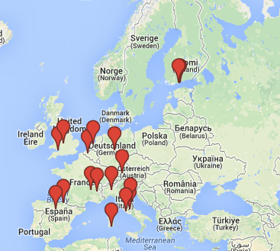
RESET composition
10 Academia,
5 Research centers,
10 Large companies,
10 European SME.
8 EU countries:
Italy, France, Spain,U.K.
Germany, Belgium,
Netherlands, Finland
Pier Carlo Ricci, University of Cagliari – RESET coordinator - http://reset.dsf.unica.it/
-

Slide 5
Thematic workpackages
WP1 Sustainable Substitution of REE in Photodevices.
Application Field: Optoelectronic, LEDs, LCDs, and Plasma Screens; Compact Fluorescent Light bulbs (CFL).
WP2 Substitution of critical raw materials in transparent conductive layers.
Application field: Panel display industry, photovoltaic, Transparent Conductive Oxide (TCO) Films for Organic Light Emissive Devices (OLEDs).
WP3 Alternative materials in components for the automotive industry.
Pier Carlo Ricci, University of Cagliari – RESET coordinator - http://reset.dsf.unica.it/
-

Slide 6
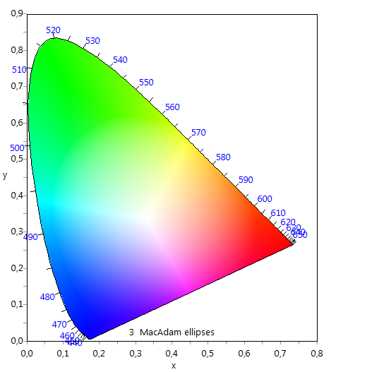
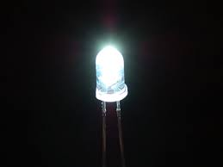
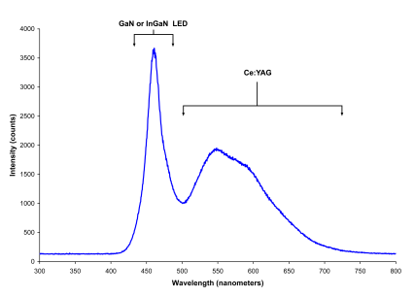
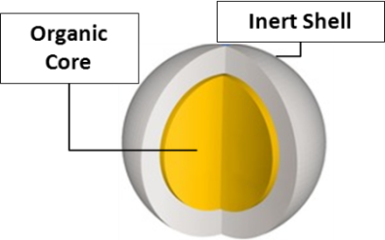
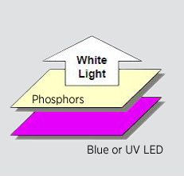
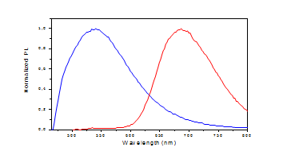
Substitution of rare earths for White LED
CRM=Ce,Y
Pier Carlo Ricci, University of Cagliari – RESET coordinator - http://reset.dsf.unica.it/
-

Slide 7
Impact
Approximately 15% of demand for phosphors is tied to demand for LCD, plasma, and cathode ray display screens as well as a variety of LED products.
The global lighting market is expected to have revenues of over EUR 100 billion in 2020, with 5 percent annual growth from 2011 to 2016, and 3 percent growth p.a. from 2016 to 2020.
Considering a starting contribution of 3-5 M€ and an estimation of the Net Profit of 8-10% of the global market of REE used ONLY in LED devices, the ROI could be calculated approximately in 375% only for this part of the lighting market
Pier Carlo Ricci, University of Cagliari – RESET coordinator - http://reset.dsf.unica.it/
-

Slide 8
Possible Action Lines
Applications | Raw materials | Value 2012(M€)
Washing machines, Dishwasher Cooling Air, conditioners | Nd, Dy | 12000
Optical fibres | Ge | 1400
Magnetic resonance imaging apparatus (MRI) | Dy, Gd, Nb, Nd, Pr,Tb | 3300
Automotive (electric motor, lighting) | REE | 850000
Pier Carlo Ricci, University of Cagliari – RESET coordinator - http://reset.dsf.unica.it/
-

Slide 9
Input for H2020 2016-2017 work programme:
Alternative substitution of critical raw materials in components for the automotive industry.
- Technology Readiness Level 3-5
Development of materials for optical fiber cables
- Technology Readiness Level 4-6
Development of materials for printed circuit boards (PCB)
- Technology Readiness Level 4-6
Pier Carlo Ricci, University of Cagliari – RESET coordinator - http://reset.dsf.unica.it/
-

Slide 10
Pier Carlo Ricci, University of Cagliari – RESET coordinator - http://reset.dsf.unica.it/
-

Slide 11
Group:
Commitment-RESET-critical Raw Elements Substitution in Electronic & optoelectronic Technologies
Website: http://reset.dsf.unica.it
Email: reset@dsf.unica.it
carlo.ricci@dsf.unica.it

Slide 12
Thank You for Your attention
Pier Carlo Ricci
University of Cagliari
H2020 Brokerage Event on Raw Materials– Brussels 14 January 2015

