Slide 1


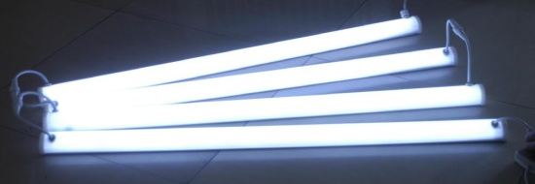

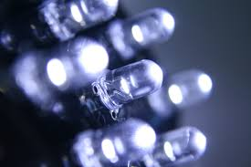
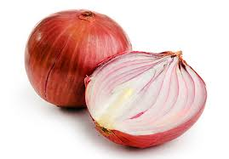
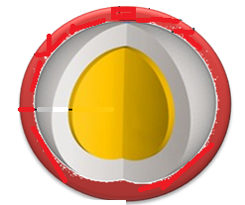
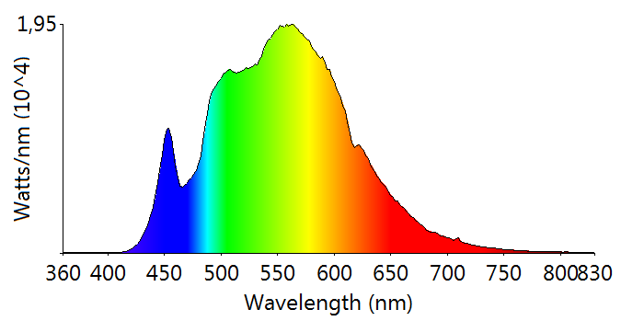
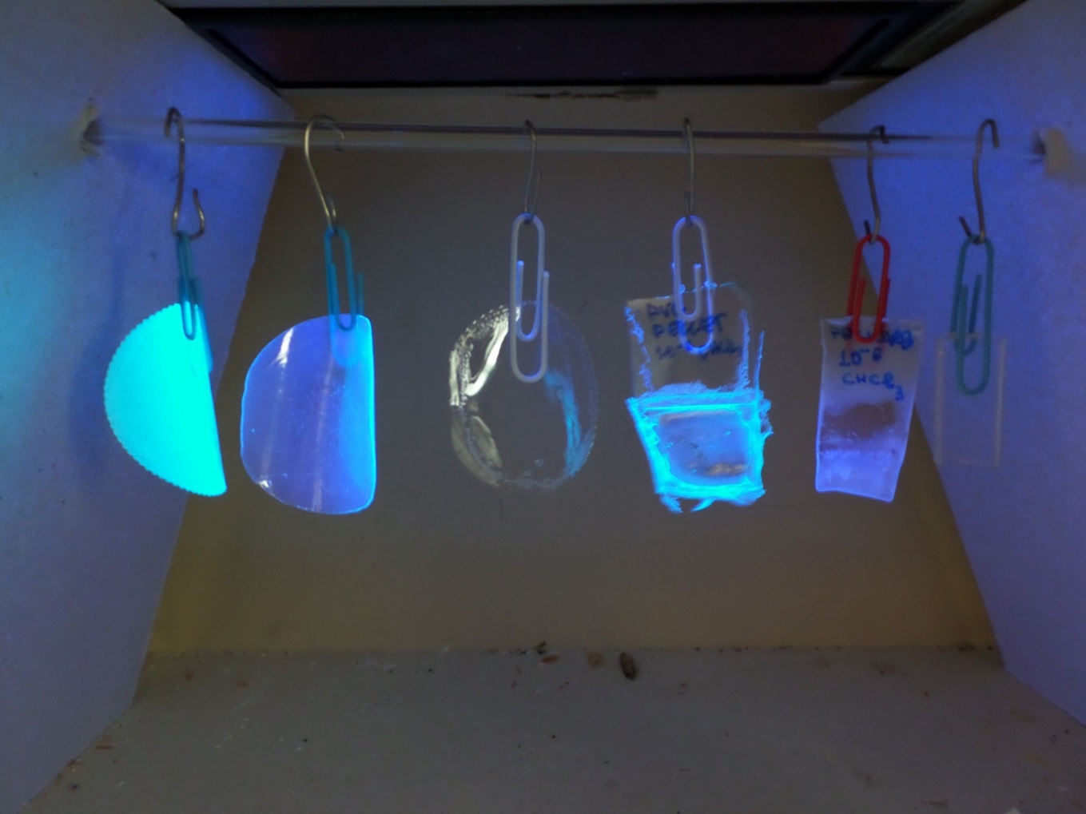

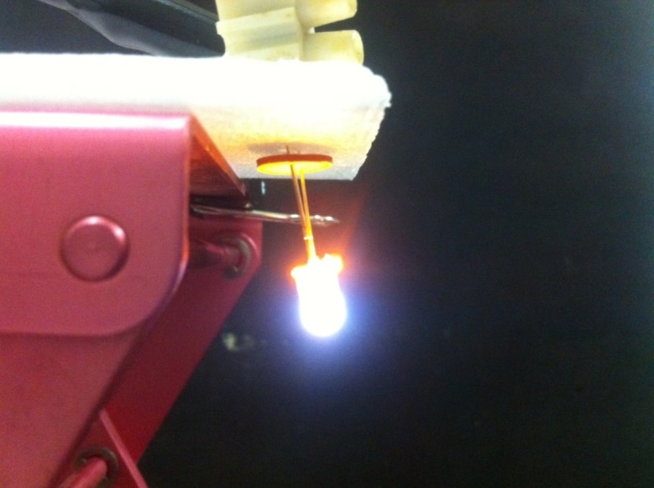
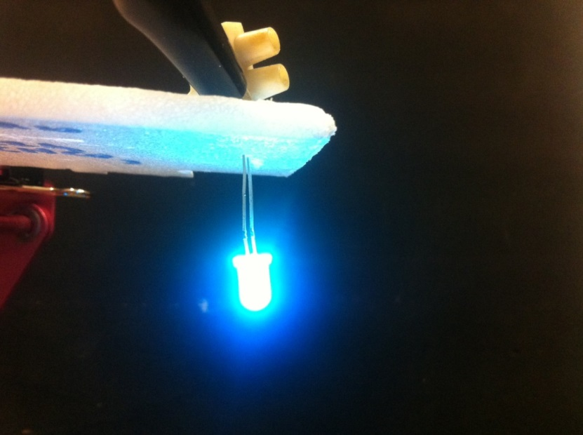
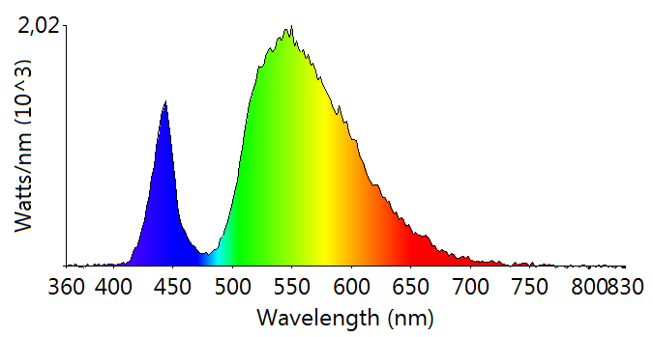





Raw Elements Substitution in Electronic and optoelectronic Technologies
Commitment recognised as a Raw Materials Commitment (RMC) by the High Level Steering Group of the EIP.
Objectives
Action area: n° I.7: Materials for electronic devices.
The actions cover the most important application areas in sectors related to the electronic and lighting industries for which CRM are a key component.
CRM free
WP
Photo-devices
Magnetic Devices
Transparent Conductive Layers
Projects
REE free permanent magnets
New W-LED
CRM free WLED
Commercial W-LED
WEEE Recycling
Nanostructured materials
Symposium E
2016 Spring Meeting (Lille, 2-6 May)
Abstract submission deadline
15 January 2016
Substitution of Critical Raw Materials: Synthesis, Characterization and Processing of New Advanced Materials in Optoelectronic and Magnetic Devices
Transparent conductive layers Rechargeable batteries, Phosphors for LED applications, Scintillators, Displays OLEDs Catalysis Photovoltaics Smart windows, Exchange-coupled nanocomposite magnets with less or no REEs New RE-free highly anisotropic magnetic materials New and energy efficient motors and generator technologies which do not depend on permanent magnets

