Slide 1

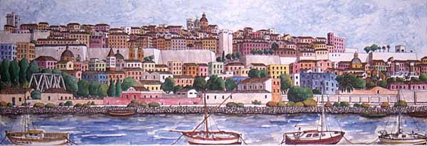
Facoltà di Scienze Economiche,
Giuridiche e Politiche
Economia e Gestione dei Servizi Turistici
Lingua Inglese
TOURISM DISCOURSE & WEBSITES
Olga Denti
a.a. 2018/2019

Slide 2
Language
Language is conveyed through a phonic or a graphic channel, through a spoken or a written medium of communication
Text v image
Ideational (experiential), Interpersonal & Textual metafunctions of language -> topic, text type, purpose, reader
Intertextuality

Slide 3
The characteristics of Tourism English
Textual features, which include textual organisation, writer/reader interaction, spatial and sequential relationships, rhetoric strategies (e.g., irony, colloquialism, stereotypes;
Linguistic-grammatical features, such as lexis, laudatory and evaluative language, persuasive and promotional discourse, monoreferentiality, brevity, syntactic patterns, premodification, grammatical devices (e.g., pronouns, interrogative clauses, imperatives, modals);
Non-textual features, i.e. images, photographs, tables, maps, and so on.

Slide 4
Tourism discourse: text types
A text is a form of exchange, not a unit of form but of meaning, it is a dialogue, a meaning-creation interaction among speakers
Narrative
Descriptive – historic sections/places, people & relations)
Regulative (or instructive) – suggestions, recommendations
Argumentative – ideas and perceptions
Expositive (or expository)

Slide 5
Multimodality
Modality: the reliability of messages, colours, contextualisation, representation of detail, depth, illumination, and brightness.
Cross-referentiality: icons, maps, photographs & texts
A photograph: an objective representation, a “legal proof”, an objective record with a merely informational value, the “true image” of the world, or, from a more social and personal point of view, a mixture of emotion and information, where the informational value is filtered through the photographer’s perspective; through his/her feelings, through social distance, visual modality, eye contact, behaviour, contextualised in different environments.

Slide 6
Images
Denotation & connotation
Images can be: naturalistic, detailed, complex, stylised, or conventional. Texture, depth, saturation, nuances of colours, etc., make the image more detailed and naturalistic, i.e. more similar to reality. Stylised and conventional images, instead, are simple, less detailed and less naturalistic.

Slide 7
Direct/indirect contact
Social response
Distance
Frame size ((i.e., close-up – head and shoulder, medium long shot – full figure, etc.)
Perspective: subjective v objective
Angle: a point of view – power & involvement

Slide 8
Tourism semiotic patterns
3 Ss: Sea, Sand & Sun (+ Sex & Socialization)
Tradition v Innovation
Sports, health, ecology, history, folklore, traditions, art, music,
Aspects of Sardità (Cadogan Guide 2003)
RAS -> the tourist Product: Nature, Testimony of the Past, People & Traditions, Wellness
http://www.sardegnaturismo.it/en

