Slide 1

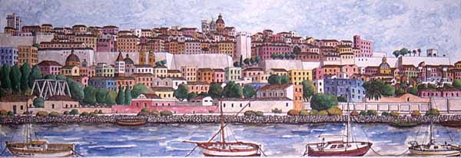
Facoltà di Scienze Economiche, Giuridiche e Politiche
Economia e Gestione dei Servizi Turistici
Lingua Inglese
UNIT 2 – NTOs
Olga Denti
a.a. 2019/2020

Slide 2
National Tourism Organizations
Public sector bodies governing the way in which tourism in a country develops
Common roles:
Legislation & policy development – to guarantee the maximum benefits of tourism for the whole country
Marketing & promotion – to create a brand image for the country

Slide 3
Infrastructure & facilities – public sector funding to keep them up
Tourist information services – Although TIOs are mostly organized and managed at local/regional level, it is a central authority who decides the basic policy & structure
Advice & training – the influence of national legislation on tourism practices in private tourism companies
A mission statement
Regional tourism boards
UNWTO

Slide 4
Brand image
What is a Brand?
What is Brand image?
The name of a products, The image of a company/destination in the market
The name used to recognize a company in the market
The identifying symbol/sign of a company
THE IDENTIFYING SYMBOLS AND VALUES OF A COUNTRY, COMMUNICATED TO THE OUTSIDE

Slide 5
Definition of “brand”
“Simply put, a brand is a promise. By identifying and authenticating a product or service, it delivers a promise of satisfaction and quality."
Walter Landor, guru of the advertising industry

Slide 6
In Brand Society, Kornberger (2010) defines brands as “identities-in-action that allow stability to be maintained while simultaneously enabling change. (...) (A)n organisation’s culture and its brand become intrinsically related to each other. (...) Identity, culture and innovation are but three concepts that are transformed through branding.”

Slide 7
Definition of “brand”
The Dictionary of Business and Management :
"a name, sign or symbol used to identify items or services of the seller(s) and to differentiate them from goods of competitors."
“What is your favourite brand of cigarettes?”
“The brand name of this soap is Flower”
“Lavazza is the brand leader in Italy among coffees”

Slide 8
Brand management issues.
A strong brand is the most valuable asset (property, plus) of successful companies/countries.
Brands are assets because, when properly managed, they provide a secure flow of income (revenue, profits) for the business/the country.

Slide 9
Branded Goods
A high quality branded product is perceived by consumers as being clearly better than competing products.
Therefore, it generates consumer preference and loyalty

Slide 10
BRAND IDENTITY & BRAND IMAGE
B. Image: The perception of your product or your brand by the consumer.
B. Identity: How you want the consumer to perceive your product or your brand.
Companies try to bridge the gap between the brand image and the brand identity. HOW??
Attracting the initial attention and recognition of customers, to differentiate the product from rivals, and to make favourable associations:
“this car/aftershave/shirt will make you attractive to women”.

Slide 11
Institutional tourism discourse
Brand identity: how the destination is communicated to the outside, for example, in institutional websites, advertising, brochures, publications in general
Brand image: ho the destination is perceived by the tourist, for example, in foreign newspapers, tourist guides, brochures, reviews, etc.

Slide 12
Niches of tourism & communication
Some examples:
cultural and heritage tourism,
religious tourism,
agritourism,
culinary tourism,
geotourism,
medical tourism,
poverty tourism,
space tourism,
wildlife tourism, sustainable and ecotourism.
And
tourism communication has been specializing with publications/websites addressing these diverse typologies and the corresponding target readers/travellers.

Slide 13
The structure of a brochure
Introduction: welcome and description
Geographical position
Climate
Places of interest
Accommodation
Means of transport
Excursions

Slide 14
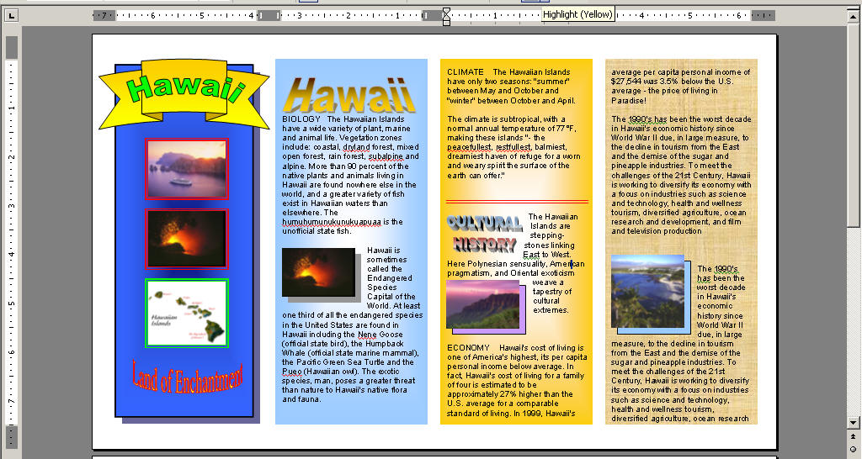

Slide 15
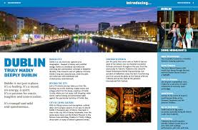

Slide 16
The structure of an itinerary
Heading: title or theme
General introduction to the highlights
Departure date(s) and place(s)
Tour description (route, duration, stopovers): DAY 1, DAY 2, ...
Tour price: what is included/excluded and type of accommodation

Slide 17
1. Bucharest and Southern Transylvania
Itinerary: Bucharest - Sinaia - Brasov - Sighisoara - Sibiu Duration: 5 days Best way of transportation: train or car
» Day 1: Bucharest Explore Bucharest, the capital of Romania. In the evening enjoy a concert by George Enescu Philharmonic Orchestra or travel to Valea Calugareasca, one of the top Romanian wine regions. After wine tasting and dinner return to Bucharest.
» Day 2: Bucharest - Sinaia - Brasov (103 miles/ 166 km) Drive or take the train to Sinaia and visit the Peles Castle. Built in 1883, Peles Castle is a masterpiece of German Renaissance architecture. The smaller Pelisor Castle features a unique collection of Viennese furniture and Tiffany glassware. Continue straight to Brasov or from Predeal take a 25 miles detour to the village of Bran to visit the 14th century Bran (Dracula’s) Castle then continue to Brasov. Overnight in Brasov.

Slide 18
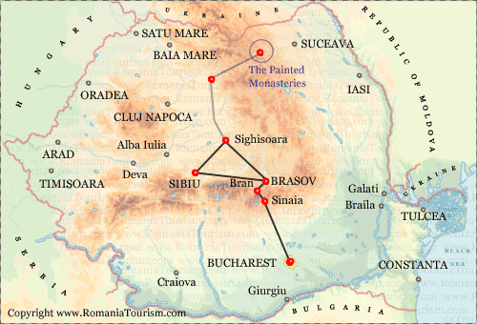
» Day 3: Brasov - Sighisoara (72 miles/ 116 km) Sightseeing in Brasov. Highlights include: the Council Square, the beautiful Saint Nicholas Church, Brasov Fortress, Franciscan Monastery. Do not miss the Black Church whose name is attributed to a fire set in 1689 by disgruntled invaders unable to breach the city’s walls. Ever since, the church and its red-tiled roof have been ash-stained. For a panoramic view of Brasov and the surrounding Carpathians Mountains take the cable car to Postavarul Peak in Poiana Brasov.
» Day 4: Day-trip to Sibiu (110 miles/ 178 km) Sightseeing in Sibiu. Highlights include: Craftsmen’s Square, Huet Square and Evangelical Church, Bridge of Lies, Goldsmith Square, Great Square, Orthodox Cathedral, Roman Catholic Church, City Hall Tower. Take an afternoon train/ drive back to Sighisoara or continue to Brasov. Overnight in Sighisoara or in Brasov.
» Day 5: Return to Bucharest (175 miles/ 282 km) or continue your journey to the Painted Monasteries in Bucovina.

Slide 19
The main linguistic features of brochures and itineraries
Objectives:
Advertising
Informative
Pronouns: we & you
Positive/hyperbolic adjectives & adverbs
Verb tenses: imperative, present, future tenses
Use of ellipsis

Slide 20
Word formation: adjectives ending in –ing and –ed Use the word given in brackets to form a word that fits in the space
Scream was probably the most ...... (frighten) film I’ve ever seen.
I get so ... (embarass) when my dad starts singing.
As the day of the exam approached, Karen became ... (increase) nervous
a. I think I’ll go straight to bed. It was a very ... (tire) journey.
b. Yes, you must be ... (exhaust)

Slide 21
I didn’t really enjoy the film. The special effects were OK but the plot was rather dull and ... (bore)
Johnny Depp is not one of my favourite actors but he gave a ... (surprise) good performance in Sleepy Hollow
You look a little ... (confuse). Don’t you understand what you have to do in this exercise?
It was quite ... (annoy) to read so many negative reviews of the film. Critics wrote that the main characters were ... (convince), but personally, I was very ... (impress) by the quality of the acting.

Slide 22
do / make / meet / take / set / have / lose
1. Managers inspire workers when they _____________ a good example.
2. We can’t ________________ the deadline. It’s unrealistic.
3.I think we’ll ________________ a profit this year.
4. Most managers ________________ their tempers when their team loses.

Slide 23
do / make / meet / take / set / have / lose
1. Managers inspire workers when they SET a good example.
2. We can’t MEET the deadline. It’s unrealistic.
3.I think we’ll MAKE a profit this year.
4. Most managers LOSE their tempers when their team loses.

Slide 24
do / make / meet / take / set / have / lose
5. Sorry, but I don’t ________________ time to help.
6. It’s too risky. We can’t ________________ a chance like this.
7. Would you ________________ me a favour?

Slide 25
do / make / meet / take / set / have / lose
5. Sorry, but I don’t HAVE time to help.
6. It’s too risky. We can’t TAKE a chance like this.
7. Would you DO me a favour?

Slide 26
Change the form of the word in brackets and complete these sentences. For example:
He manages one of the biggest football clubs in the country. (manage)
The new manager improved moral in the department. (manage)
Increasing salaries is only one way to increase ____________________. (motivate)
Fear of ____________________ is another way to inspire staff. (fail)
Many managers believe ____________________ cannot be trusted. (employ)
I have ____________________ with my six subordinates today. (appraise)

Slide 27
Change the form of the word in brackets and complete these sentences. For example:
He manages one of the biggest football clubs in the country. (manage)
The new manager improved moral in the department. (manage)
Increasing salaries is only one way to increase MOTIVATION (motivate)
Fear of FAILURE is another way to inspire staff. (fail)
Many managers believe EMPLOYEES cannot be trusted. (employ)
I have APPRAISAL with my six subordinates today. (appraise)

Slide 28
Change the form of the word in brackets and complete these sentences.
Did you hear about the basketball ____________________who strangled a subordinate? (coach)
We’re in danger of setting our ____________________too high. (expect)
The board of ____________________ meets four times a year. (direct)

Slide 29
Change the form of the word in brackets and complete these sentences.
Did you hear about the basketball COACH who strangled a subordinate? (coach)
We’re in danger of setting our EXPECTATION too high. (expect)
The board of DIRECTORS meets four times a year. (direct)

Slide 30
Morphological suffixes
Market research and national brand image
Most people ……………… (association) the word brand with makes of car, clothes, watches, or drinks, but …………. (nation) tourism authorities try to promote a brand image for their own country. The idea is …….. (work) on the different things people associate with your country. These things are often quite ……. (vary), it’s important to bring them together into a smaller number of broad ………. (conceptualize). …………… (type) a country might create a brand image using two, three, or four broad concepts.

Slide 31
Phonetics
A
B
/'mænɪdʒə(r)/
/ˌɪnstɪˈtjuːʃən/
/ˈkʌltʃəʳ/
/‚məʊtɪ'veɪʃn/
/ˈwelkəmɪŋ/
/brænd/
/ˈɪmɪdʒ/
/ˈkʌntrɪ/
/pəˈsepʃən/
/ˌɪnspəˈreɪʃən/
/trəˈdɪʃənl/
/ɪksˈpɪərɪəns/

