Slide 1

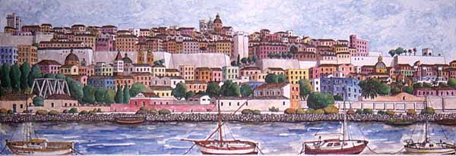
Facoltà di Scienze Economiche, Giuridiche e Politiche
Economia e Gestione dei Servizi Turistici
Lingua Inglese
UNIT 3 – MANAGING TOUR OPERATIONS
Olga Denti
a.a. 2019-2020

Slide 2
Managing tour operations
A package holiday, package tour or inclusive tour – a tourism product including:
Travel to the destination
Local transport (airport transfers, car hire, …)
Accommodation & meals
Activities (day trips, sports, visits, etc.)

Slide 3
Internet & IT: from scheduled tours sold through travel agencies to custom/tailor-made tours & tour operators’ greater flexibility
Co-creation: a customer approaches a tour operator with an idea for a specific package. If the idea is viable, the tour operator supports the customer in the planning, marketing & sales processes.

Slide 4
Tour operations
Complexity: organization process + marketing
Two years in advance + fixed prices – a high-risk business
Marketing managers – promotion
Tour managers – accompanying & supporting
Resort managers - @ the tourist destination – negotiating & controlling

Slide 5
Morphological structures
PROFITABLE???
Unprofitable, profitability
Active (adj.)
activist (n.)
Misery (n.)
Miserable (adj.)
Senior (adj/n.)
Seniority (n.)
Custom (n.)
Customer (n.)
Resident (n.)
Residential (adj.)
Energy (n.)
Energise (v.)

Slide 6
Morphological structures
DIVERSE DIVERSITY DIVERSIFY
INSPIRE INSPIRED UNINSPIRED INSPIRATION
OPPORTUNE OPPORTUNITY
DESIGN DESIGNER
PUBLIC PUBLICITY PUBLICIZE publication
COMMERCE COMMERCIAL UNCOMMERCIAL
REVOLUTION REVOLUTIONARY REVOLUTIONISE
REPUTE REPUTATION REPUTED REPUTABLE DISREPUTABLE
COMFORT DISCOMFORT COMFORTABLE UNCOMFORTABLE
RETAIL RETAILING RETAILER

Slide 7
Word formation Complete the text with the words in brackets in the correct form
Many travel and tourism organizations ……. (continue) assess and monitor the quality of customer service they provide. They do this …….. (make) sure that their service is meeting the ……… (need) of customers and, if not, then …………. (necessity) changes can be made. ………… (custom) needs and expectations are ……. (constant) changing, so any customer service programme in travel and tourism must ……. (be) flexible.
In ………….. (generally) terms, organizations may use benchmarking to identify aspects of their own products, services, or processes which …… (underperformance).

Slide 8
Phonetics
A
B
/dɪsˈmɪsəl/
/ˈtʃælɪndʒ/
/nɪˌgəʊʃɪˈeɪʃən/
/ɪnˈdʌstrɪəl/
/rɪˈleɪʃənʃɪp/
/ˈnesɪsərɪ/
/əˈsesmənt/
/səˈdʒestʃən/
/səkˈsesfʊl/
/rɪˈfjuːzəl/
/ˌɪntəˈnæʃnəl/
/tʃiːp/

