Slide 1
Economia regionale e dell’innovazione Scienze Economiche, Lezione 4 – Measuring Knowledge
Stefano Usai
email: stefanousai@unica.it
tel.: 070-6753766

Slide 2
I. A Model of Knowledge and the Economy

Slide 3
I. A Model of Knowledge and the Economy
Our goal is to discuss various types of data that can be used to measure the effects of knowledge on the economy.
To begin, we consider a model of how knowledge affects the economy.
This is important because we can measure inputs and outputs of the process, but we rarely measure output directly.
Thus, different measures may be right for different tasks.
Note: in the following diagram, circles represent observed variables, and boxes represent unobserved variables.

Slide 4
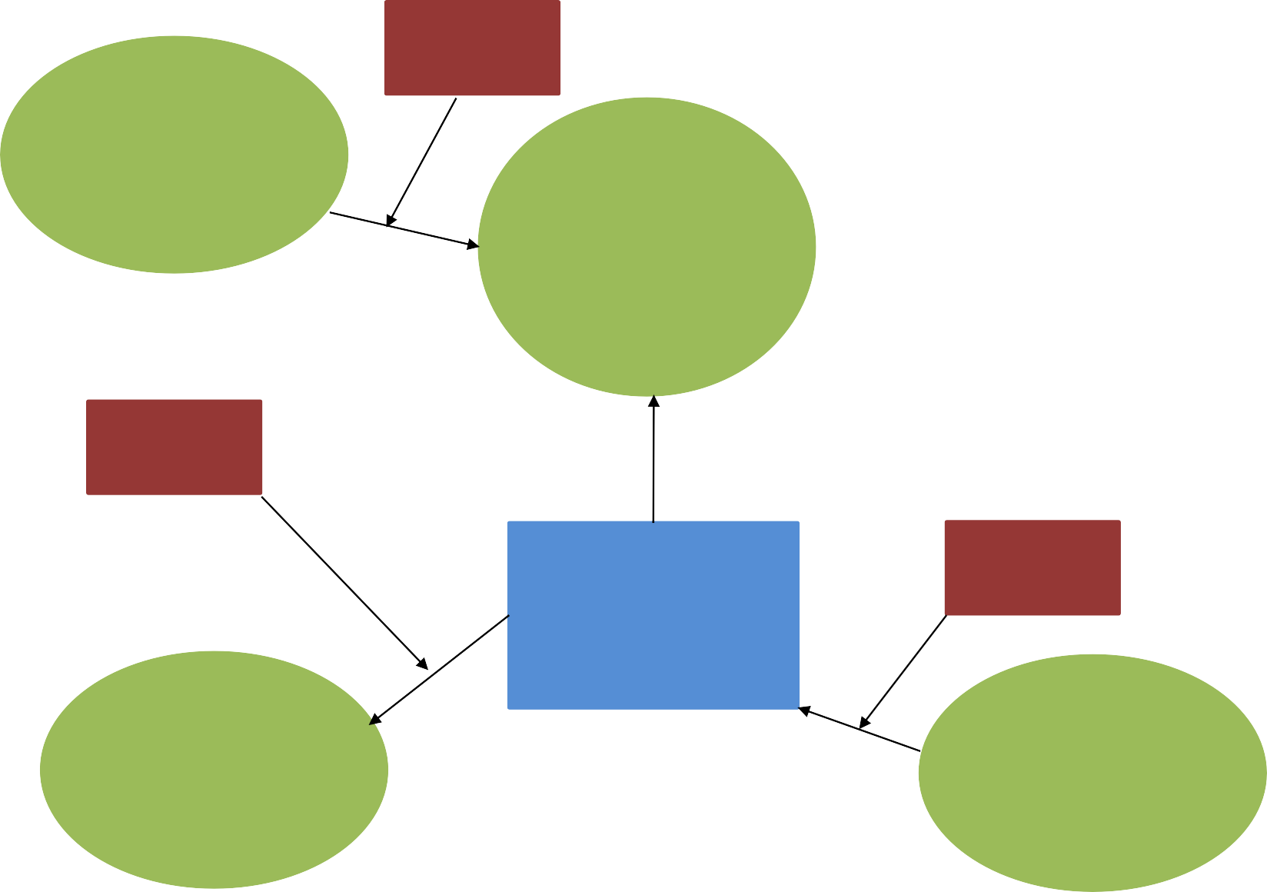
I. A Model of Knowledge and the Economy
Unobserved
Other observed inputs (e.g. labor, capital)
influences
Expected benefits of knowledge (e.g. economic growth)
Unobserved influences
Unobserved influences
Additions to knowledge
Output (e.g.
Patents, Publications)
Research (e.g.
R&D)
circles represent observed variables, and boxes represent unobserved variables

Slide 5
I. A Model of Knowledge and the Economy
Although we would like to observe knowledge directly, we cannot. We can observe:
Inputs into the creation of knowledge
For example, we can look at R&D data, spending on higher education, etc
Outputs of the creation of knowledge
We can look at patents & publications
We can measure the effect of knowledge on economic growth (e.g. TFP).
Unfortunately, there are unobserved effects between any of the observed variables and the effect of knowledge. For example:
Not all R&D is measured and not all R&D is qualitatively equal.
Not all inventions are patented and not all patents are equally valuable.
Changes in quality might be mismeasured because of price changes.

Slide 6
II. Measuring the Effect of Knowledge

Slide 7
II. Measuring the Effect of Knowledge
Since any discussion of different measures of research effort ultimately want to tell us about the effect of knowledge on well­being, we begin by discussing how economists measure the effect of knowledge on the economy.
Possible measures of the effect of knowledge on output:
One “measure” is simply the portion of growth that cannot be explained by changes in the inputs of the economy. We called this total factor productivity (TFP).
Using g to represent growth rates, this can be defined as
gTFP = gQ ­-sKgK ­-sLgL
Economists can treat knowledge as an input to production, and use the direct measures to find the effect of these inputs on output.
Economists can calculate the rate of return on an investment
More appropriate for micro­level studies of a single technology.
One drawback of case studies is that they tend to focus on successful inventions (or large failures).
Thus, they might not be typical of innovation as a whole.

Slide 8
II. Measuring the Effect of Knowledge
Complications
A difficulty with interpreting output data is that changes in prices may hide technological change – changes in quality.
One reason is that the Consumer Price Index (CPI) (and the Producer Price Index) do not accurately measure changes in quality.
For example, if we look at health care costs, we would see large increases in spending. However, the quality of care received has improved. Computers are similar.
A 1998 government study estimated that omitting technological change overstated inflation by 0.6% ­­ that is, inflation is actually 0.6% lower.

Slide 9
II. Measuring the Effect of Knowledge
Complications
Example of effect of higher quality: measuring benefits of the Internet
GDP only measures economic transactions.
Doesn’t consider consumer surplus – the extra welfare generated by a new innovation
Suppose, in 1999, broadband cost $20/month
In 2006, suppose broadband costs $17/month
Consumers who were willing to buy broadband in 1999 now receive a $3 surplus: the consumer surplus from broadband would be $5­7 billion per year
Note that this is conservative:
it assumes consumers get the same benefit (e.g. have the same demand curve) for broadband in 1999 and 2006
In reality, if demand is higher (e.g. because of more contents available on Internet today), surplus is also higher.

Slide 10
II. Measuring the Effect of Knowledge
Other potential problems
Knowledge assets are hard to measure
Can count stocks of accumulated R&D, but don't know future value of what it will create.
Capital stocks hard to measure
Consider differences in labor productivity between the US and Europe
Non­farm labor productivity in the US grew 3%/year from 1996­ to 2002, and has been growing
In contrast, European growth rates were around 2%/year, and falling.

Slide 11
II. Measuring the Effect of Knowledge
Why are these different?
Increased capital stocks in the US (e.g. IT) made labor more productive.
TFP controls for this:
For GDP/Inputs, both numerator and denominator up.
For GDP/L, only numerator up.
Quality adjustments are also important.
The US corrects prices to control for the increased quality of computers.
Makes GDP growth bigger, because acknowledges we get more power for the same cost.
In the European data, for the TFP calculation, both the numerator and denominator are incorrect. Thus, some of the error cancels out.
In contrast, for GDP/L, only the numerator is incorrect. Growth is measured too slowly, so labor productivity suffers.

Slide 12
III. Measures of Research Inputs

Slide 13
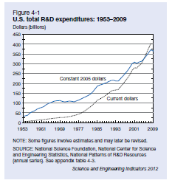

III. Measures of Research Inputs
US R&D $402 billion in 2009
– Real R&D expenditures grew 5.8%/year from 2004-09

Slide 14
III. Measures of Research Inputs
The most common measure of input into the scientific process is measures of research and development (R&D) spending.
Advantages of R&D data
R&D offer direct measures of the inputs into the research process
For example, if you want to know the opportunity cost of increasing government funding for R&D, what matters is how much money is spent.
Data is available at a reasonable level of detail both from a sectoral and a territorial point of view (but patents are better…)
Disadvantages/complications
The return on a dollar of R&D may vary.
That is, the level of inputs is certainly correlated with, but not a direct measure of, the output of research.
Time lags
A research project may take a couple of years. Thus, the effects of R&D might not be immediate.
Biased government R&D.
If if goes to defense or space exploration, the benefits of these projects will not traditionally show up in output measures, since not typically sold in markets.

Slide 15
III. Measures of Research Inputs
Global R&D in 2009: $1,276 billion
Growing roughly 7% per year over last decade
One-half done in 3 countries:
• US: $402 billion (31%)
China: $154 billion (12%)
Japan: $138 billion (11%)
Share of GDP devoted to R&D higher in high-income countries
• US: 2.88%
• Japan: 3.33%
Germany: 2.76%
China: 1.70%
Brazil: 1.08%
Egypt: 0.21%

Slide 16
IV. Measures of Research Output

Slide 17
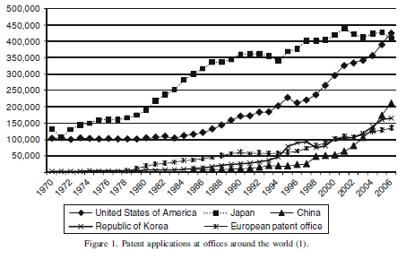
IV. Measures of Research Outputs
Source: Nagaoka et al. (2010), “Patent Statistics as an Innovation Indicator,” Handbook of Economics of Innovation, vol 2

Slide 18
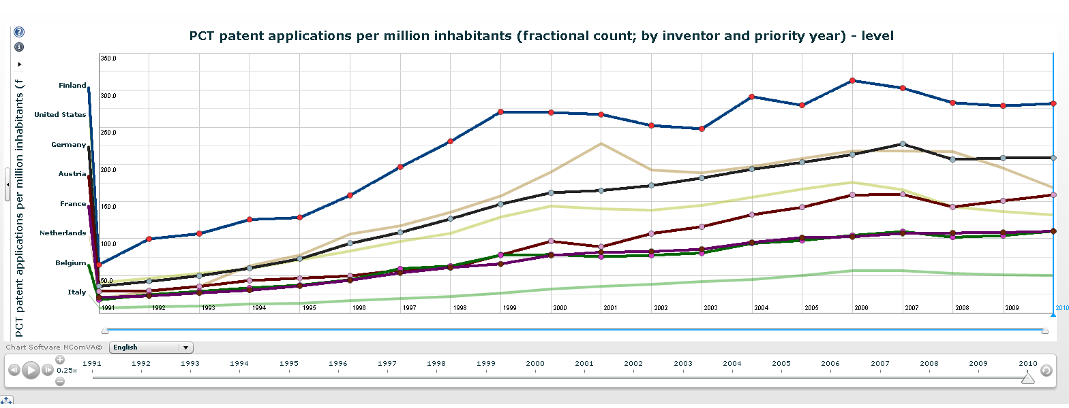

Slide 19
IV. Measures of Research output
Measures of output can help to measure the unobserved success or failure of research inputs. However, there are other complications with the data.
Two widely used measures of the research patents are:
Patents
Scientific publications

Slide 20
IV. Measures of Research output
Patents
Patents provide monopoly rights to an invention in return for publicly disclosing the invention.
Advantages of patent data
Long time series of historical data available US patent system began in 1793
Greater detail available on patents than with R&D statistics
All patents must meet at least some minimum quality standard. To receive a patent, an invention must be:
• Novel • Useful • Non­obvious
What do patents measure?
A patent represents the output of a research process.
However, not all inventions are patented, and not all patents are equal.
Only a subset of inventions are brought to market.

Slide 21
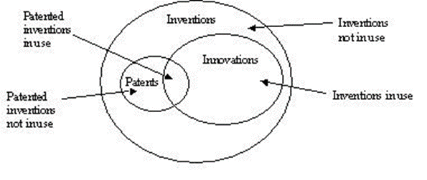
Patents
Furthermore, only a subset of inventions is patented

Slide 22
IV. Measures of Research output
Implications
Patents proxy for the knowledge created in the research process, but they are not a complete count of innovation.
How problematic these variations are, depends on how the data is used.
To look at innovation across time, we need to assume that the likelihood of patenting an invention stays the same across time.
Not always true. Patent policy changes do affect patenting rates. However, one can control for these if necessary.

Slide 23
IV. Measures of Research output
Implications
To compare data across industries, we need to assume that the likelihood of patenting is the same across industries.
This is not true. However, one can control for these if necessary
When comparing patents across countries, we need to be aware of differences in national patent systems or different propensity to patent due to national factors. This
This is why we prefer international offices
Patent application data is more reliable than patent grant data
Grants depend on patent office behavior. For example, fewer patents were granted in 1979, due to budget cuts.

Slide 24
IV. Measures of Research output
Validation of Patent statistics
Despite these problems, much research has been done using patent statistics. Typical findings:
There is a strong correlation between patents and R&D within an industry, a region, a country.
The ratio of patents to R&D has, until recently been falling. As a result, the correlation across time is not as strong.
Is this due to changes in patenting behavior, or changes in research productivity?

Slide 25
IV. Measures of Research output
Validation of Patent statistics
Despite these problems, much research has been done using patent statistics. Typical findings:
Variations in quality
Most patents have little value. However, some are extremely valuable.
Possible controls for quality:
Patent citations
Patent citations are references to earlier patents.
Weighted patent counts tend to correlate stronger with other measures of technological change.
Citations are also useful to tell us about knowledge flows.
The number of countries patent protection is granted in.
Because you have to pay an application fee in each country, inventors only file abroad if the invention is good.

Slide 26
U.S. Patent and R&D Trends
400,000
350,000
300,000
250,000
200,000
150,000
100,000
50,000
0
Total R&D (millions 2005 US $)
Domestic Patent Applications
Domestic Patent Grants

Slide 27
IV. Measures of Research output
Scientific publications
Research on scientific publications is known as bibliometrics.
Alternative methods:
- Publication counts
- Citation counts
Again, controlling for quality is an important issue.
Counting citations made to each publication is a way to control for quality.
For example, in the article by May, note that the top publishing countries do even better when citations are used to control for quality.

Slide 28
IV. Measures of Research Outputs
Citations per publication 1993-2002
– Switzerland | 1.59 (ranked 14th for pub counts)
– US | 1.41
– Denmark | 1.33
– Netherlands | 1.33
– UK | 1.21
This controls for the average quality of a publication
The US moves to second, and the rest of the rankings change significantly.
David Popp
The Maxwell School of Citizenship and Public Affairs
Syracuse University

Slide 29
IV. Measures of Research Outputs
Share of publications (1997-2001)
US
UK
Japan
Germany
France
Share of citations
US
UK
Germany
Japan
France
34.86%
9.43%
9.28%
8.76%
6.36%
49.43%
11.39%
10.02%
8.44%
6.89%
David Popp
The Maxwell School of Citizenship and Public Affairs
Syracuse University

Slide 30
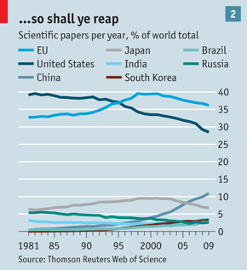
IV. Measures of Research Outputs
Publications in developing countries are growing
Also note that there are more collaborations
– 35% of articles in top journals are collaborations across countries

Slide 31
V. R&D and Productivity

Slide 32
V. R&D and Productivity
Once we have measures of productivity and R&D, we can use the data to assess the effectiveness of the inputs (e.g. R&D) on the desired output (e.g. productivity).
As noted before, methods include case studies and econometric studies. Here we look at some of the econometric evidence.
Methodology
Theory
Results of private returns to R&D
Results on social returns to R&D

Slide 33
V. R&D and Productivity
Methodology
Two related approaches:
Production function studies estimate the effect of R&D on output or TFP
Cost function studies estimate the effect of R&D on costs
Both are related by theory, but have different data requirements
Data can be cross­-section, time series, or both

Slide 34
V. R&D and Productivity
Theory
Begin with a production function that includes R&D as an input:
This leads to the following estimating equation, which uses growth rates:
gQ = A + αgK + βgL + χgR + εt
χ is the elasticity of output with respect to R&D growth
Problems
Endogeneity due to omitted variables (e.g. if firms productive for reasons unrelated to inputs, such as managerial skill)
Measurement issues
Quality changes might not be captured in measures of output
Aggregating past research activities into one measure of knowledge is difficult.
For example, there may be time lags between R&D and the observed effect. Moreover, does R&D depreciate?
Potential double counting – are labor and K used for R&D also included in L & K?
If R is confined to a specific industry or firm, spillovers from other industries are not measured

Slide 35
V. R&D and Productivity
Theory
Cost function models are similar, but relate R&D to reductions in production cost
Require more data, as need to know the costs of inputs
A typical cost function would be:
cost = f(Q, w, r, R&D)
Input prices likely exogenous, since determined for the whole industry
However, other endogeneity issues remain

Slide 36
V. R&D and Productivity
Results of private returns to R&D
Elasticity of R&D on output positive and significant, typically around 0.1 – 0.2
Findings are stronger in micro­level cross sections than macro­level time series studies.
Elasticity of R&D on TFP positive and significant, typically around 0.2­ - 0.3
Elasticity using cost functions typically around 0.2­0 - 0.25
In all studies, there is greater variation across industries than within industries.
That is, R&D has different effects in different industries.

Slide 37
V. R&D and Productivity
Results on social returns to R&D
Two ways to study spillovers
Compare estimated private returns to R&D to estimates of returns to other types of investments. Typically, the returns to R&D are higher.
Include variables to capture outside R&D.
For example, look at R&D done by industries that supply a firm
These studies support the idea of spillovers
An often-­cited ratio is that social returns are 4x that of private returns.

