Slide 1
THE COMPLEMENTARITY EFFECTS OF PROXIMITY DIMENSIONS ON KNOWLEDGE SPILLOVERS:
Emanuela Marrocu, Raffaele Paci, Stefano Usai
University of Cagliari and CRENoS
FP7-SSH-2010-2.2-1, SEARCH project
Topics in Economics

Slide 2
Motivation and aim
Wide consensus based on both theoretical (Grossman and Helpman, 1990; Rallet and Torre, 1999) and empirical grounds (Jaffe, 1989; Coe and Helpman, 1995) that innovation activity depends on investments in research, knowledge and human capital as much as on interactive learning and the circulation of ideas.
The capacity of a region to generate, transmit and acquire knowledge and innovation depends on a multifaceted set of factors: investment in R&D, education and training, work force experience, collaboration networks, technology transfer mechanisms, mobility of researchers.
The main aim of this paper is to analyze the interaction of internal and external factors in determining the technological performance of European regions.

Slide 3
Specific aims
More specifically:
we investigate to what extent the regional innovative capacity depends on intra-regional characteristics (mainly R&D expenditure and human capital) and on the ability to exploit inter-regional spillovers;
we analyze the mechanisms, in the form of different kinds of proximity and networks, which facilitate the emergence of such spillovers and how they interact - are they complementary or substitute?
Notes:
3

Slide 4
Literature background
The literature on Endogenous Growth and on New Economic Geography provides theoretical backing to the idea that there are technological spillovers within and across regions and countries.
Such spillovers are obviously related to the geographical dimension since close-by agents are believed to have a better innovative performance because of pecuniary and pure technological advantages.
The French School of Proximity argues that geographical proximity is neither necessary nor sufficient: there is a separate role for a-spatial links among economic entities (Carrincazeaux - Coris, 2011).
Knowledge exchange and technological interdependence across agents are influenced by four other proximity dimensions: institutional, technological, social and organizational (Boschma, 2005).
  (Influence is not always positive: there might be either too much or too low proximity: there is an optimal level of proximity beyond which economies may experience lock in)
Notes:
4

Slide 5
Types of Proximity, beyond geographical space
Institutional proximity (I): the effective transmission of knowledge may be facilitated by a common institutional framework, such as laws and norms (Maskell-Malmberg, 1999; Gertler, 2003).
Technological (or cognitive) proximity (T): knowledge transfer requires appropriate absorptive capacity (Cohen-Levinthal 1990) which entails an homogenous cognitive base with respect to the original knowledge in order to understand and process it effectively.
Social (or relational) proximity (S): social closeness facilitates firms capacity to learn, absorb external knowledge and innovate since this breeds trust which, in turn, lowers transaction costs and facilitate collaboration (Granovetter, 1985).
Organisational proximity (O): relations within the same group or organisation influence the individual capacity to acquire new knowledge coming from different agents (Kirat - Lung 1999).
Notes:
5

Slide 6
Types of Proximity, beyond local knowledge spillovers
Another relevant concept for the analysis of knowledge flows is the distinction between unintented and intented spillovers (Maggioni et al., 2007). Proximity may induce a process of knowledge diffusion that does not depend directly on economic agents’ decisions.
In the case of intended spillovers, knowledge flows across a-spatial networks where agents exchange ideas on a voluntary base thanks to formal or informal agreements (Cowan and Jonard, 2004).
Exchanges may be market or non market mediated, that is either pecuniary or pure technological spillovers (Breschi and Lissoni, 2001 and 2009, and Antonelli, 2007)
Notes:
6

Slide 7
Empirics on knowledge spillovers
Seminal paper on geographical spillovers: Jaffe 1989.
Extensions for US consider mainly geographical proximity (Acs et al 1992; Audretsch and Feldman, 1996; Anselin et al 1997; O´hUallachain - Leslie 2007).
Contributions on EU regions introduce technological and institutional proximity (Bottazzi-Peri 2003, Greunz 2003, Moreno-Paci-Usai 2005).
Role of social/relational networks (as a regional indicator) together with geographical proximity within a KPF: Maggioni et al. 2007, Lobo –Strumsky 2008 for US MSA’s, Crescenzi et al. 2007 for both US and EU, Miguelez-Moreno 2010 for EU NUTS2 regions.
No contributions on the role of organizational proximity on regional innovation performance. The only partial exceptions are Sorensen et al 2009, Oerlemans-Meeus 2005 at the firms level.
Notes:
7

Slide 8
Our contribution
We extend the Knowledge Production Function (KPF) model by including human capital as an additional input (important factor to account for the absorptive capacity)
Broad territorial coverage 276 regions in 29 countries (EU27 plus Norway, Switzerland).
We assess the role of different types of proximity and networks in channeling technological spillovers across regions
Computation of direct, indirect and total impact of each factor
Spatial econometric techniques are applied to assess the role of different (two at a time) proximity dimensions simultaneously
Tentative and preliminary interpretation for policy suggestions

Slide 9
Empirical model/1
General form for the KPF model as a log-linearized CD function:
lower case letters indicate log-transformed variables, i=1,…276 regions
Dependent variable
  inn: yearly average of patents per capita in 2005-2007
Internal determinants of innovation
  - rd: R&D expenditures over GDP
  hk: human capital, graduates over total population
Controls
  population density
  regional share of manufacturing activities
Proximity factors
  - G, I, T, S, O proximity matrices
Notes:
9

Slide 10
Dataset
  We measure the impact of local factors at the beginning of the decade, 2002-2004
  on innovative performance measured at the second half of the decade, 2005-2007

Slide 11
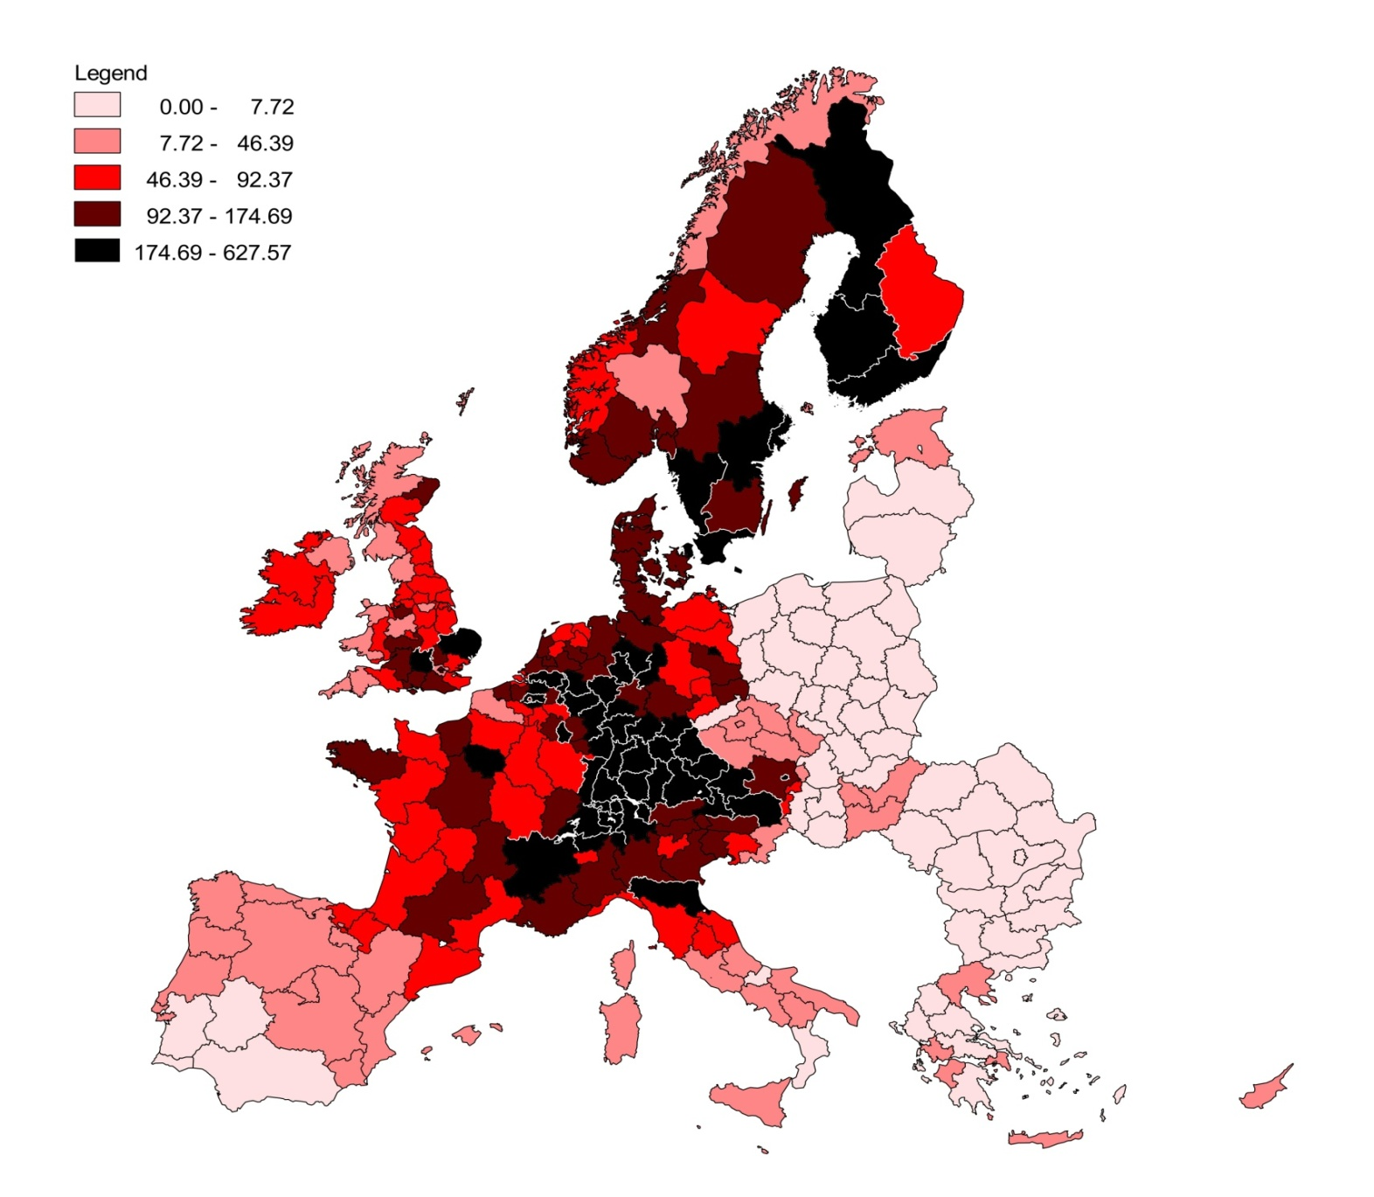
Patents (per million inhabitants)
Notes:
11

Slide 12
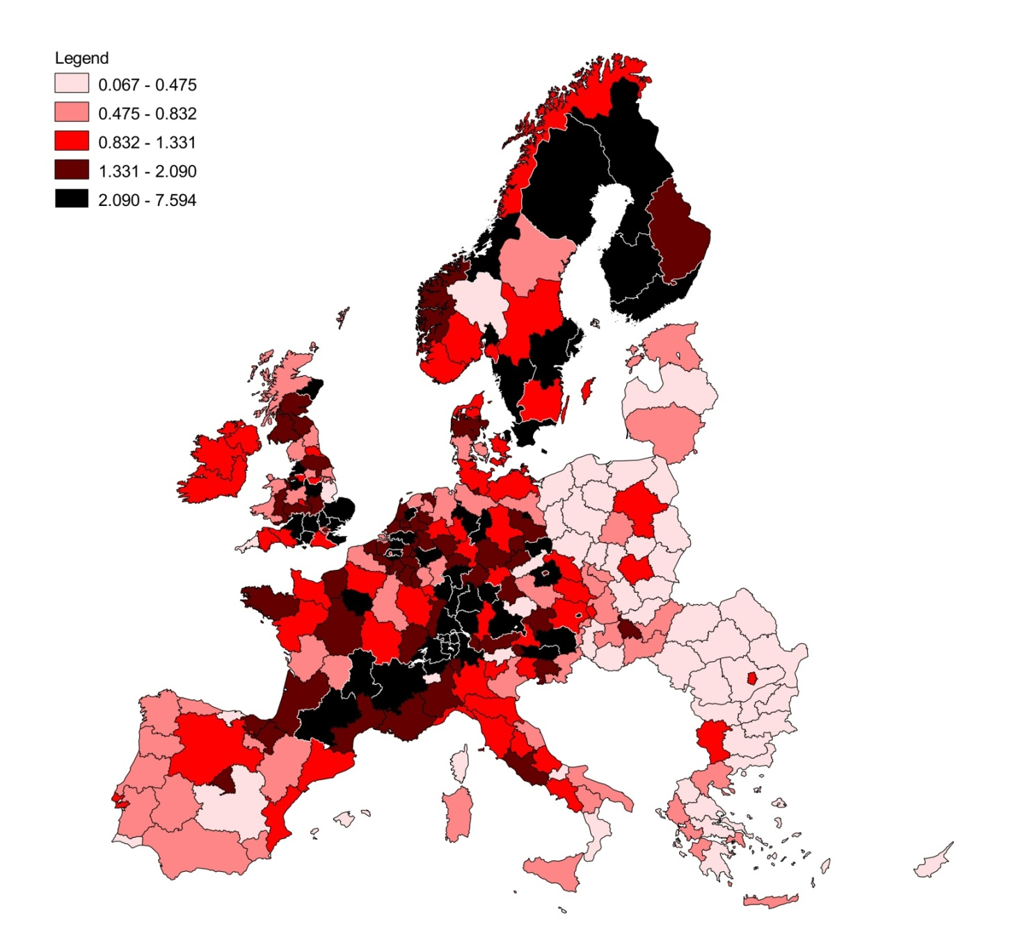
R&D expenditure (over GDP)
Notes:
12

Slide 13
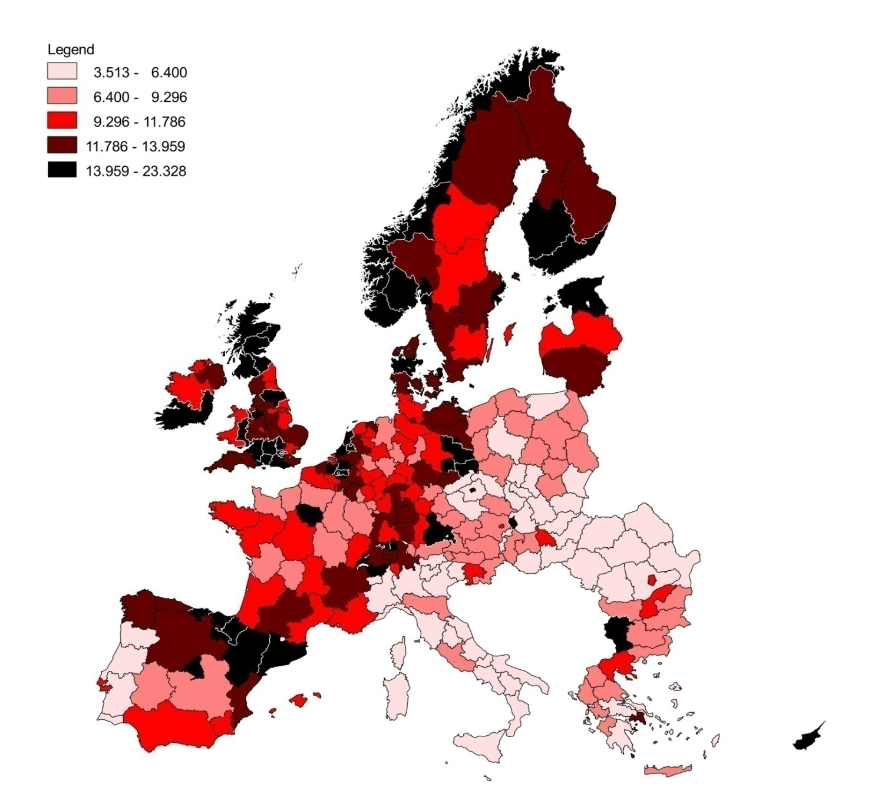
Human capital (per capita)
Notes:
13

Slide 14
Estimation strategy
Extensive preliminary analysis carried out to select the most adequate spatial specification using several alternatives: SEM, SAR, SDM, SLX, SDEM models (mainly based on the geographical proximity G, inverse of distance in Km, d_{ij} ≤600)
We choose to specify the estimation model as a Spatial Autoregressive (SAR) model, which takes the following form
where W is a weight matrix, which describes the interconnectivity among the regions.
Assessment of other proximity measures (alternative W’s): I, T, S, O
Assessment of direct and indirect effects (as in Autant-Bernard and Le Sage, 2010)
Assessment of complementarity among different proximity measures, G, I, T, S, O, based on a two-spatial-weight matrix SAR model (Lacombe, 2004)
Notes:
Controllare reference Autant-Bernard and Le Sage
14

Slide 15
Proximity: proxies and measures
Institutional proximity: matrix with value 1 if two regions belong to the same country and zero otherwise.
Alternative: country dummies.
Technological proximity: matrix of similarity index for the distribution of patenting activity among 44 sectors computed for each pair of regions
(t_{ij} ≥0.50).
Alternative: matrix of correlation coefficients.
Social proximity: matrix of co-inventorship relations among multiple inventors of the same patent when they reside in different regions. The intensity of links among inventors located in different regions catches the existence of a social network.
Alternative: migration flows or FP5 networks.
Organizational proximity: matrix of the affiliation of the applicant and the inventors of a patent to the same organization when they reside in different regions (inter-regional connections within the same organization or group).
Notes:
Although we are aware that referring mainly to individuals’ characteristics the extension at the aggregate regional level of the social and organisational networks is not straightforward, we believe that it can, nonetheless, provide interesting insights in unveiling what drives knowledge flows across Europe.
15

Slide 16
Spatial KPF with alternative proximities

Slide 17
Empirical model/2
            The best way to proceed would be to insert all four proximities in the same estimation model. Unfortunately, the available estimation codes for spatial econometrics do not allow this first best and we look for a second best.
            We use a SAR model estimated by including two different proximity-lagged terms at a time in order to account for complementarities between pairs of knowledge spillovers channels (Lacombe, 2004). The two-weight matrix SAR model is specified as:
Notes:
17

Slide 18
A step towards assessing complementarity
Two-weight-matrix SAR models:
Notes:
18

Slide 19
A further step: model combining…
A combined model is obtained on the basis of probabilities calculated from biased-adjusted AIC values (Burnham and Anderson, 2002)
Notes:
19

Slide 20
… and overall effects
A numerical “what if” exercise
R&D
if the ratio R&D/GDP increase by 10%, from an average actual value of 1.4% to 1.56% it produces a total increase (+4.1) on patents (per million inhabitants) from the observed average value of 105 to the new estimated value of 109.1. The increase is due to the direct effect for 2.5 and to spillovers for 1.6.
Human capital
an increase of 10% in the share of graduates, from the average value of 10.5% to 11.6%, yields a total increase in patents (per million inhabitants) of +23, 13.7 attributable to direct effects and 9.3 due to spillovers.

Slide 21
Main conclusions
R&D and human capital are essential components for technological progress but with quite different impacts.
All dimensions of proximities are significantly related to innovative performance and they represent complementary channels of knowledge transmission.
Cognitive or technological proximity is individually the most effective and its role is enhanced by geographical closeness.
Social and organizational dimensions are important too, although the size of their spatial lag is more modest. Besides, these two dimensions turn out to be not always complements since the two proxies suffers from some overlapping.
Once the combined effect of all proximity measures is considered, it results that the effect of human capital on the production of knowledge is sizeable due to the spillover of external knowledge favoured by the absorptive capacity of well educated population within the region.

Slide 22
Policy implications/1
Importance of policies aiming at increasing the endowments of well educated labor forces, given their strong and pervasive role in determining both the internal creation and the external diffusion and absorption of knowledge. Education in general and universities in particular have to be central in any innovation policy.
The existence of several channels of interregional spillovers calls for a coordinated strategy able to achieve different targets with diverse instruments.
More policies should aim directly to knowledge diffusion and absorption taking into account the diverse institutional and industrial contexts :no “one size fits all” policies (Todling and Trippl, 2005 and Asheim et al, 2011)
Practically, policies should support and encourage the formation of dense networks among regional innovation systems which go beyond geographical clusters.

Slide 23
Policy implication/2
Technological proximity matter much more than the geographical one in influencing innovation spillovers. This suggests the implementation of specific industrial policies to support the formation and the functioning throughout Europe of a-spatial industrial clusters characterized by proximate technology.
Finally, the presence of externalities which exploit social interregional relations requires policies designed specifically to provide a balanced set of incentives to motivate economic agents towards more cooperative behaviours and actions with economic entities in other regions.

Slide 24
 | Key aspect | Too little proximity | Too much proximity | Policies
Technological/Cognitive | Knowledge and absorptive capacity | Lack of understanding | Lack of novelties, technological lock-in and unintented spillovers | Education to create a common wide knowledge base and specific industrial policies
Organizational | Control and routines | Opportunism and lack of coordination | Excess bureaucracy and vested interests | -
Social/ Relational | Trust (based on social relations) | Opportunism and high transaction costs | Lack of pro-competitive behaviour | Inclusive policies which facilitate a mix of social and market relations
Institutional | Trust (based on common institutions) | Opportunism and lack of coordination | Lock-in and inertia | Public coordination and standard, intercultural exchanges
Geographical | Distance | Lack of tacit knowledge transmission and of other local spillovers | Local enclaves | Regional policies with a mix of local buzz and global pipelines

Slide 25
Proximity measures: summary statistics
Notes:
25

Slide 26
A further step: model combining…
A combined model is obtained on the basis of probabilities calculated from biased-adjusted AIC values (Burnham and Anderson, 2002)
Notes:
26

