Slide 1
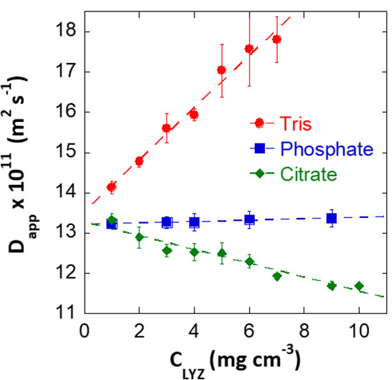
Specific Buffer Effects on Lysozyme
Gruppo: Interface Theory and Modelling, Contatto: Drew Parsons <drew.parsons@unica.it>
Objective
Lysozyme Diffusion
To understand the influence of buffer ions
on protein interactions
Steps
Preparation and execution of theoretical models.
Comparison with and interpretation of existing experimental measurements.
Types of Activities
Cloud computing
Expected Results
We expect to find an explanation of why the diffusion coefficient of lysozyme decreases in citrate buffer, while increasing in tris buffer

Slide 2
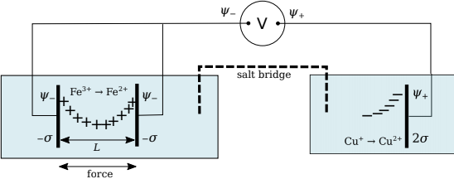
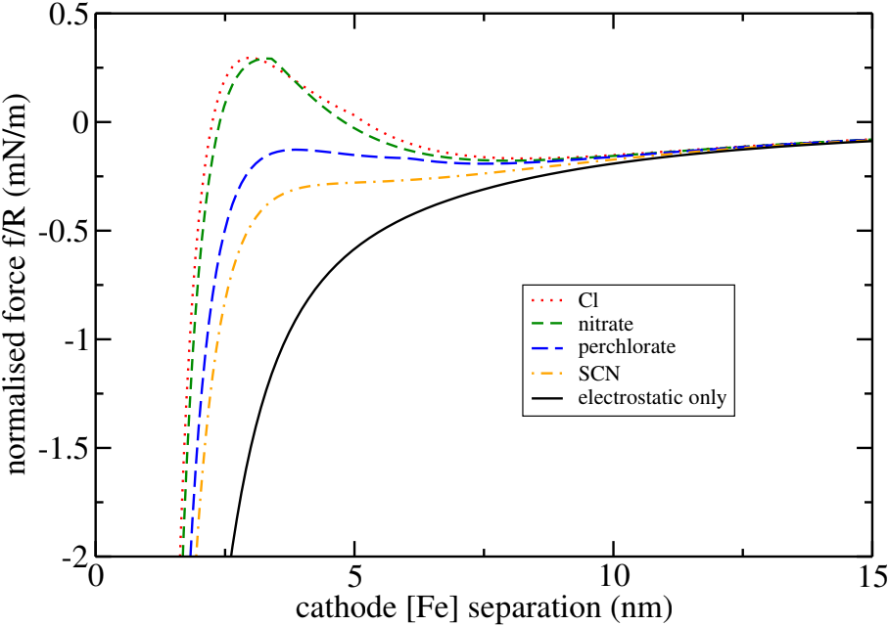
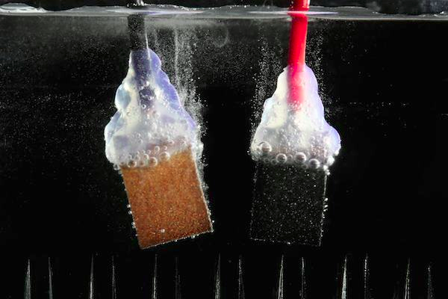
Modelling hydrogen adsorption at electrodes
Gruppo: Interface Theory and Modelling, Contatto: Drew Parsons <drew.parsons@unica.it>
Objective
Ion adsorption
To investigate and model adsorption of H⁺ ions, H2 molecules
and bubbles at electrodes during electrolysis
Steps
Review literature.
Preparation and execution of theoretical models.
Types of Activities
Cloud computing.
Expected Results
Building insight into adsorption of hydrogen and liberation of nanobubbles from electrode surfaces, relevant to the nascent hydrogen economy.

Slide 3
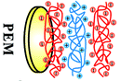
Modelling polyelectrolyte films
Gruppo: Interface Theory and Modelling, Contatto: Drew Parsons <drew.parsons@unica.it>
Objective
To investigate the influence of electrolyte ions on
the thickness of polyelectrolyte films
Polyelectrolyte multilayers
Steps
Review literature.
Development of new computer code.
Execution of theoretical model.
Types of Activities
Cloud computing.
Quantum chemistry
Expected Results
Interpret how ions influence swelling or compression of polyelectrolyte films, including protein films.

